Slide 1



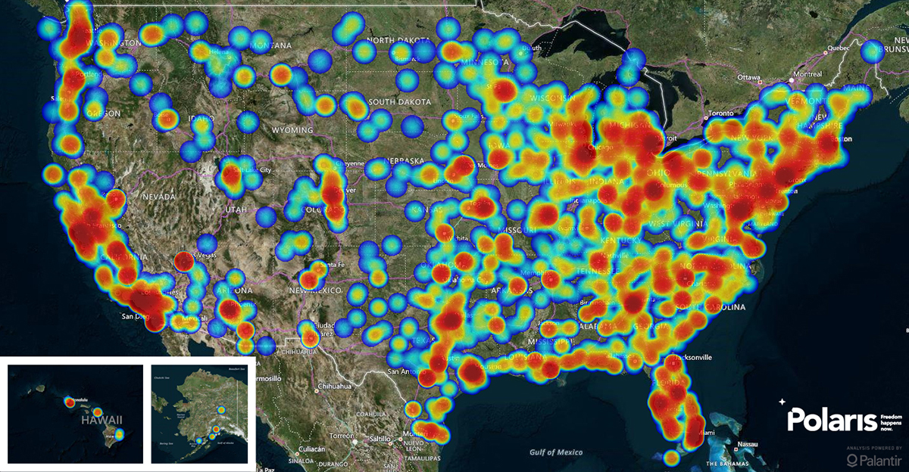
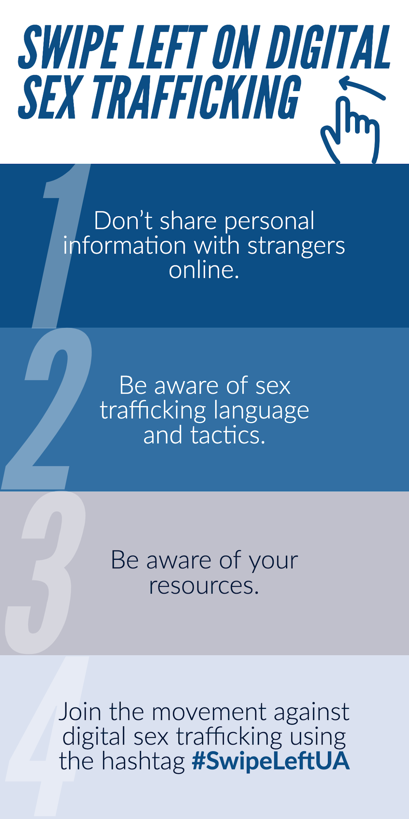
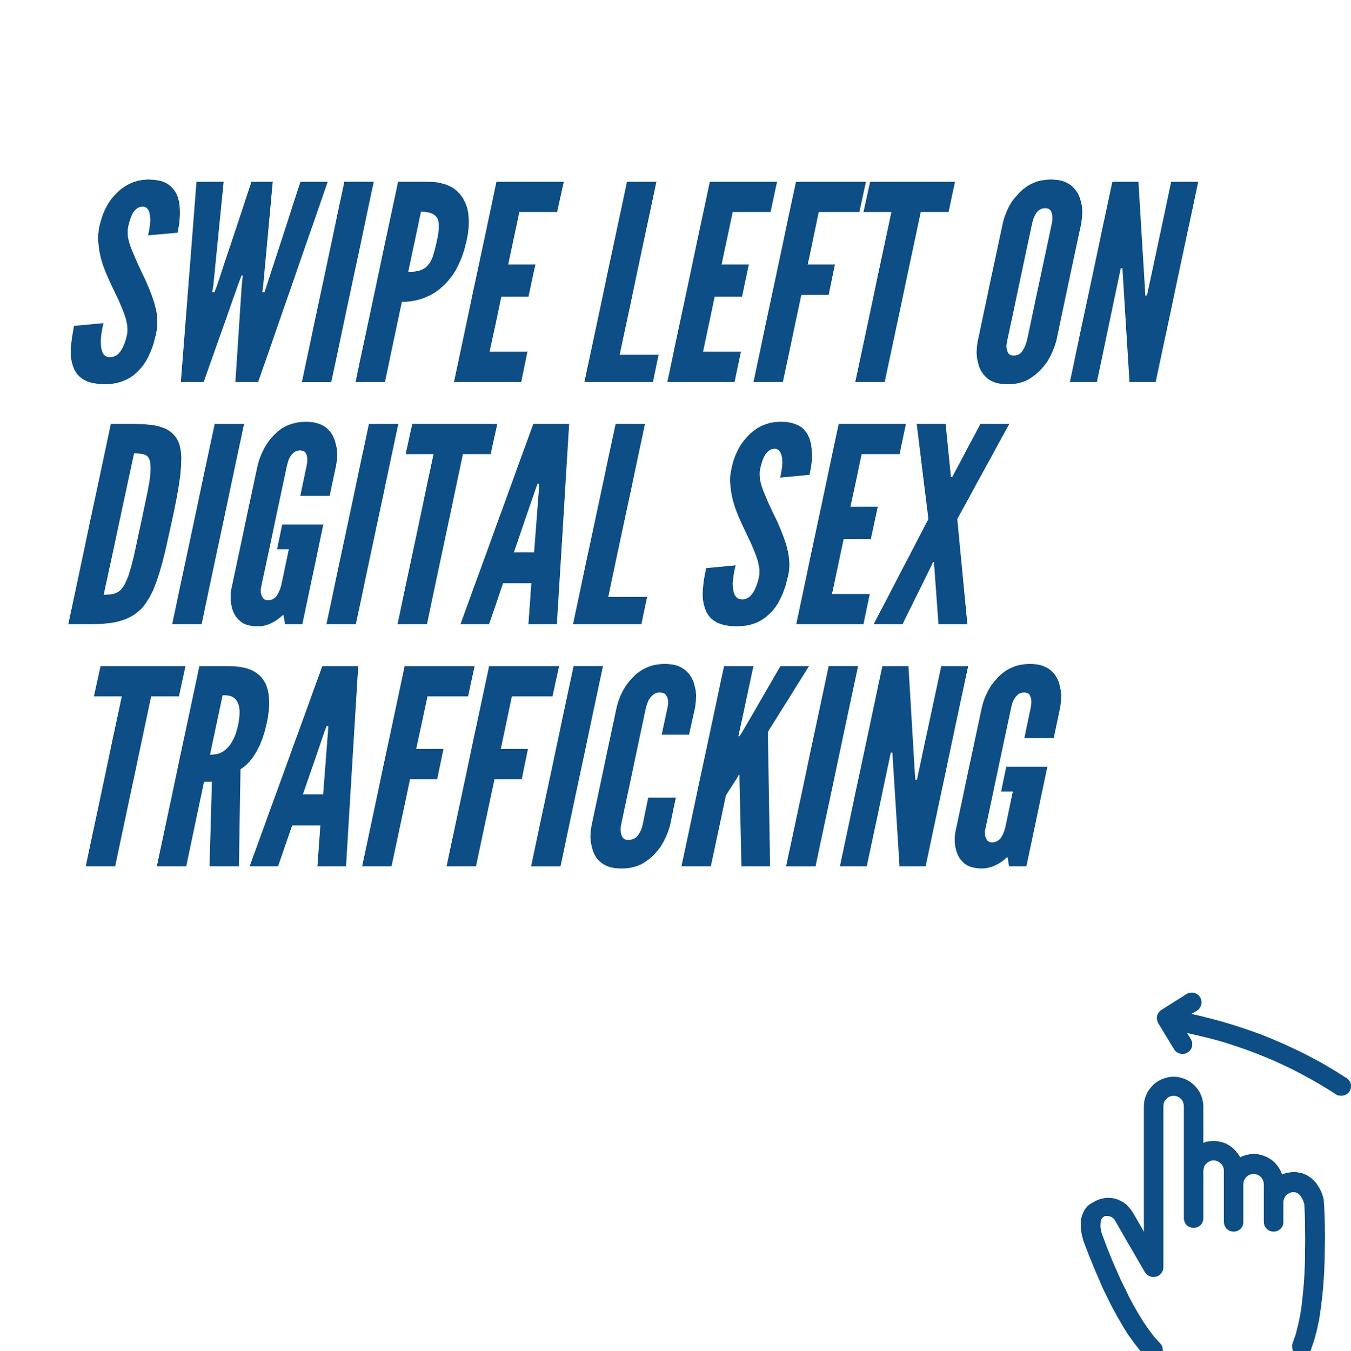
Swipe Left UA
Emma Bearden, Josh Britt, Tana Early, Kate Pitts and Carina Villarreal
In Partnership with Alabama BEAMS and others
Project Activities
Evidence of Need
Intended Outcomes
Sustainability
We will create an infographic to spread awareness of sex trafficking by digital means. It will be distributed through educational dorm move-in packages by the Women and Gender Resource Center to all freshmen. The infographic will be front and back with 1-4 steps to protect yourself and others against digital sex trafficking along with the hashtag #SwipeLeftUA.
We will host a workshop on sex trafficking through digital means led by the West Alabama Human Trafficking Task Force. The workshop will cover examples of incidences of human trafficking, particularly in the Tuscaloosa area, along with the dangers of “sugar baby” dating through websites like SeekingArrangements.com. At the end of the workshop we will train participants in how to recognize a sex trafficker and take action.
We will create a social media campaign, primarily throughout Human Trafficking Awareness Month in January. “Swipe Left UA” accounts will be created on Twitter, Facebook, and Instagram, posting information to raise awareness of sex trafficking through digital means and reminders of our events. We will partner with student organizations and Greek life, taking their pictures with a “Swipe Left UA” sign. To ensure we reach a large audience we will host a competition in the beginning of January, in which the organization who gets the most likes on their picture wins $500 towards the cause of their choice.
We will table for two weeks in January, enlisting Blackburn students to spread further awareness of sex trafficking through digital means. The tabling will take place in the Ferguson Student Center, where we will educate students and hand out “#SwipeLeftUA” stickers.
Human trafficking is the second-largest criminal industry in the world today. While human trafficking is widespread, it is heavily concentrated in the southeastern United States along U.S. Interstate 20. The proximity of this sex-trafficking corridor to the University of Alabama makes the threat of internet-based sex-trafficking recruitment all the more severe. According to the Polaris Project, the use of the internet and social media platforms to coerce individuals into sex trafficking has been and continues to be a significant issue. They report that victims are baited by false job offers or flattery and feigned romance, and are offered to be flown out to accept the job or to meet in person, only to be trafficked.
In a related vein, an increasingly popular gateway to sex trafficking is sugar-dating. Essentially, an older middle to upper-class man or woman seeks to maintain a relationship, often involving some sort of sex work, with a much younger individual. The definition of this relationship varies greatly, and it is most frequently between an older man and a younger woman. There are many internet platforms dedicated to connecting sugar daddies and sugar babies, but one of the most ubiquitous is SeekingArangements.com. This website often targets college women, using advertisements like: “Sugar Baby University: Say goodbye to college debt and hello to a higher class education,” and offers lucrative account incentives for signing up with a .edu email address. According to the site’s founder, Brandon Wade, of the over 800,000 members, around 35% are students. This cycle of young college students being pulled into a world of sex work, without fully realizing what they are doing, is often perpetuated by a culture of acceptance for the practice, though there is a significant lack of firm knowledge and legal protections in this field than in prostitution.
The intended outcome of this project is to increase awareness on the dangers of sex trafficking by digital means, create a dialogue on campus around the subject in congruence with Human Trafficking Awareness Month, and educating incoming students through information disseminated annually at move-in.
Each initiative has specific goals and outcomes. Through the partnership with the Women and Gender Resource Center, we intend to reach the incoming student population through providing the educational materials as a part of move-in packages. Early exposure to this information can help form cautious decisions in relation to online dating sites.
Through the educational workshops led by the West Alabama Human Trafficking Task Force, we intend to train attendees to identify sex trafficking in their communities and how to take action against it. Not only will the workshops help create much needed dialogue on a hard subject but also equip attendees to identify human trafficking in their own communities.
Both the social media campaign and tabling initiative have the same end goal in mind, to make university students aware of the dangers of digital sex trafficking. Through these two initiatives, we hope to make the dangers of digital sex trafficking more well known through relatable and memorable exchanges either through social media or a conversation at one of the tabling events.
Our main method of continued implementation is our educational outreach. One training session at our workshop will reach many people, and each person who attends our training session will be equipped with the knowledge to educate others, exponentially growing the population of individuals at the University of Alabama who will be aware of the signs of sex trafficking and how to help survivors.
We will also make our educational materials available every fall semester to be included in the dorm move-in packets for incoming freshman. This is vital time to educate college students as they are faced with lots of new opportunities and information, and are vulnerable to pressure from external sources. Learning about sex trafficking as freshman will also increase the pool of students equipped to identify trafficking situations, and help survivors.
Sex Trafficking
Hotspots Across the U.S.
Budget
The budget details all materials needed for the workshop, including promotional materials, as well as catering for participants and volunteers. Additionally, the budget details the monetary incentive for organizations to participate in the social media competition which will kick off our social media campaign in the Spring of 2020. Lastly, the budget details printing costs for flyers and stickers, which will be distributed at campus tabling events as well as to each incoming freshman in the fall of 2020.
Bibliography
"The 'Sex Trafficking Superhighway' most Alabamians don't even ...." https://yellowhammernews.com/the-sex-trafficking-superhighway-most-alabamians-dont-even-realize-runs-through-their-state/.
"On-Ramps, Intersections, and Exit Routes - Independent Anti ...." https://www.antislaverycommissioner.co.uk/media/1266/on-ramps-intersections-and-exit-routes.pdf.
"On-Ramps, Intersections, and Exit Routes - Independent Anti ...." https://www.antislaverycommissioner.co.uk/media/1266/on-ramps-intersections-and-exit-routes.pdf.
"Study details link between social media and sex ... - Phys.org." 8 Oct. 2018, https://phys.org/news/2018-10-link-social-media-sex-trafficking.html.
"“Sugar dating” among college students in the ... - Csustan.edu." https://www.csustan.edu/sites/default/files/groups/University%20Honors%20Program/Journals_two/18_odonnell.pdf
"“Sugar dating” among college students in the ... - Csustan.edu." https://www.csustan.edu/sites/default/files/groups/University%20Honors%20Program/Journals_two/18_odonnell.pdf
"Sugar; is it still sweet? | ENC Human Trafficking Non ...." 27 Feb. 2017, https://encstophumantrafficking.org/sugar-still-sweet/.
"“Sugar dating” among college students in the ... - Csustan.edu." https://www.csustan.edu/sites/default/files/groups/University%20Honors%20Program/Journals_two/18_odonnell.pdf
"The 'Sex Trafficking Superhighway' most Alabamians don't even ...." https://yellowhammernews.com/the-sex-trafficking-superhighway-most-alabamians-dont-even-realize-runs-through-their-state/.

