Slide 1
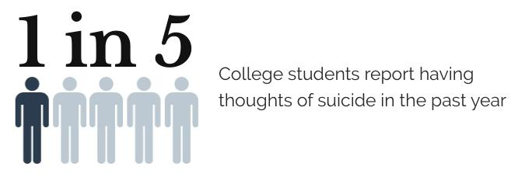
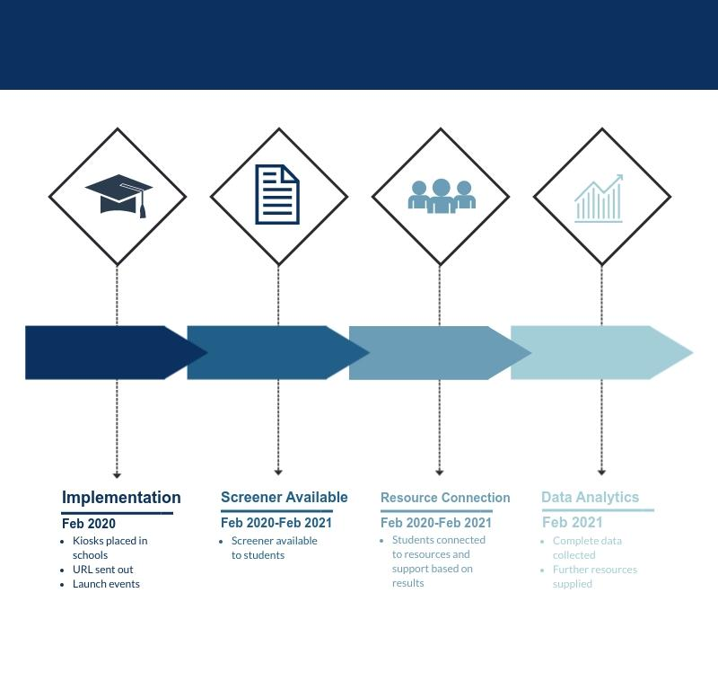
Tuscaloosa Collegiate Mental Wellness Initiative
Payti Harrison, Olivia Smith, Taylor Roberson, Marquis Hollingsworth
Stillman College, Shelton State Community College, and
and MindWise Innovations
Project Activities
Evidence of Need
Intended Outcomes
Sustainability
MindWise Innovations provides an online mental health screener that can be purchased for colleges and universities. The screener screens for alcohol use, anxiety, bipolar disorder, depression (adult and adolescent), eating disorders, problem gambling, posttraumatic stress disorder, psychosis, and substance misuse. Students are able to get a “check-up from the neck up” in less than two minutes with easy accessibility. With the customizable URL and a kiosk, students will be able to access the screener anywhere and at anytime. The goal of Tuscaloosa Collegiate Mental Wellness Initiative is to bring an affordable and easily accessible mental health resource to Stillman College and Shelton State Community College in Tuscaloosa. Due to the fact that neither school has mental health resources available to students, this screener will provide students with screening opportunities and a personalized list of resources available to them. After purchasing the screener, students will be able to take a free screener even if they do not have access to a smartphone, laptop, etc. The screener is anonymous, and limited data will be taken and reported to each school to direct further resources based on behavioral health trends. The kiosk will help make mental health check-ups just as common as blood pressure screenings, hopefully working to end the stigma around mental illness and getting treatment. The anonymity will encourage students to take the screener without the fear of stigmatization or discrimination. After students complete the screener, a page will show their results as well as personalized resources available to them in Tuscaloosa based on those results. Bridging the gap between health care providers and students is an important feature included with the online screener. Tuscaloosa Collegiate Mental Wellness Initiative aims to encourage students to have discussions about mental health and take the next steps in receiving treatment.
A point of contact will be established at both Stillman College and Shelton State Community College for MindWise management and ongoing data analytics. There is an option to renew the subscription to continue use of the kiosk and web address; however, each college will have access to data collected from students using the kiosk and URL that can be utilized for future mental wellness initiatives specifically addressing identified needs of the student population. Tuscaloosa Mental Wellness Initiative hopes that with the data provided, each school will be able to identify specific behavioral health trends that need to be addressed on their campuses. By promoting the kiosk and campaign, the Tuscaloosa Collegiate Mental Wellness Initiative will inspire action by Stillman College and Shelton State Community College administration and student groups to promote a more inclusive, aware, and mentally well campus.
The MindWise Innovations online screening package will address the lack of accessibility and affordability of mental health screening and risk assessments on the Shelton and Stillman college campuses. After introducing kiosks to each campus, The Blackburn Institute will promote the launch of the kiosk and customizable web address to further increase accessibility of mental health resources. The launch event at each campus will be preceded by three days of tabling and an extensive social media campaign.
The launch at each campus includes distinguished speakers, an opportunity for students to network with speakers, administration, and student groups to engage in meaningful conversations surrounding the topic of mental health awareness and support. To encourage attendance at the campus launch events, The Blackburn Institute will partner with student groups on campus to cosponsor the event, as well as academic departments to offer extra credit for students attending. Food will be provided and prizes given away to those in attendance. Speakers at the events will include Stillman College School of Business Dean, Isaac McCoy, Tuscaloosa County Judge Ward D. “Rob” Robertson, III, Tuscaloosa Mayor Walt Maddox , and a member of Shelton State Community College Administration. Volunteers will be transported to Stillman and Shelton for tabling and the kiosk launch events via The University of Alabama vans. Four Blackburn students will be present at each tabling session and twenty will be volunteering at both launch events.
With data obtained from the 2017 National Survey on Drug Use and Health (NSDUH) and the Substance Abuse and Mental Health Services Administration (SAMHSA), the National Institute of Mental Health compiled statistics on mental health in the United States. It was estimated that 46.6 million adults aged 18 or older in the United States had AMI in 2017, which would be equivalent to 18.9% of all adults. Young adults aged 18-25 years were the age group with the highest prevalence with a 25.8% prevalence. Females had a higher prevalence of AMI at 22.3%, and adults reporting two or more races had the highest prevalence (28.6%) followed by white (20.4%). Of 46.6 million adults with AMI in 2017, only 19.8 million mental health services (42.6%). Among young adults aged 18-25, only 38.4% accessed mental health services. According to a facts graphic provided by the National Alliance on Mental Illness, the average delay between onset of symptoms and intervention is between eight and ten years.
During young adulthood most mental health disorders have peak onset. Anxiety disorders, including social phobia, panic disorder, generalized anxiety disorder, and post-traumatic stress disorder, are among the most prevalent with approximately 11.9% of students suffering. Depression is also very common with approximately 7-9% of students suffering, followed by bipolar disorder at 3.2%. Alcohol and illicit drug use is also prevalent during this age, with one in five college students meeting the criteria for alcohol use disorder and one in twenty college students meeting the criteria for drug use disorders. There is a high rate of mental illness in college students with mood disorders, anxiety disorders, and substance abuse being the most common. Stillman College and Shelton State Community College do not offer any mental health resources for students. The mental health screening service that will be provided will address each school’s need by connecting students to support and resources available in Tuscaloosa and surrounding areas.
Budget
The budget accommodates for the launch events and tabling at Stillman and Shelton. The majority of the funds supports the schools in providing the kiosks and personal web addresses for the students of the respective colleges. The price of the kiosk and personal URL are based on the population of the community. After the Mindwise products are paid for, the rest of the budget will be utilized for everything needed with the events. To help with risk management the Initiative provides transportation to tabling and the events, using University of Alabama issued sedans for the four students going to table each day and two vans for the twenty student volunteers needed for each of the launch events. Food and drinks will be provided at the two launch events for all in attendance. The money provided by the Daniel Foundation of Alabama will allow the Tuscaloosa Collegiate Mental Wellness Initiative to improve affordability and accessibility of mental health resources to underserved college students in Tuscaloosa.
Bibliography
“Mental Illness.” National Institute of Mental Health. U.S. Department of Health and Human Services, February 2019. https://www.nimh.nih.gov/health/statistics/mental-illness.shtml.
“Mental Health Facts: Children and Teens.” Mental Health Facts: Children and Teens. National Institute of Mental Health, 2016.

