Slide 1
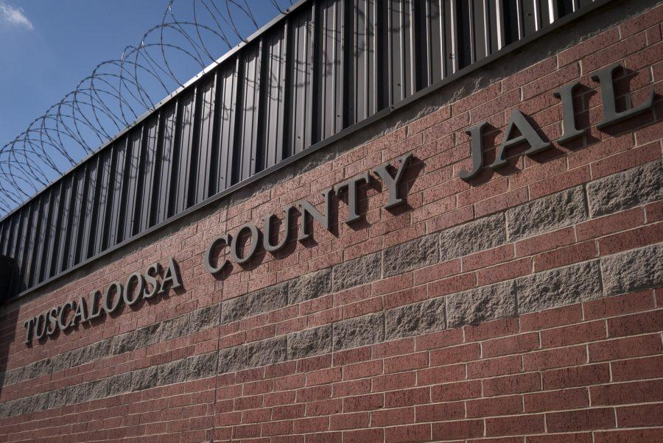
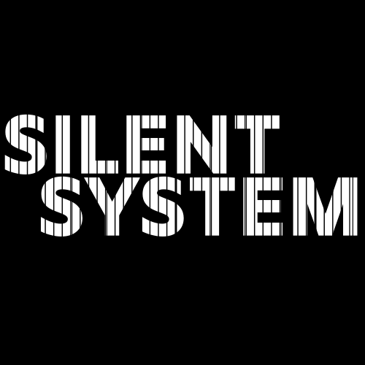
Silent System
Tattum Denham, Cameron Dobbs, Will Henson, Micah Presley, Samuel Reece
Community Partner: Alabama Appleseed
Project Activities
Evidence of Need
Intended Outcomes
Sustainability
“Silent System” is a proposed short film drawing inspiration from elements of participatory action research. It aims to collect stories in Tuscaloosa, Alabama about the human toll of Alabama’s criminal justice system on inmates and their social networks and present those stories to community members, leaders, and policy makers. Animation, written stories, and other alternative forms of storytelling as identified by participants will ensure that their stories are told meaningfully and in their voices.
Phase 1:
15 volunteers in teams of 5 will collect interviews from community members and begin to form a “script” for the film.
Audio and video equipment will be obtained through University Libraries, transportation via UA vans.
Phase 2:
10 volunteers will animate 30-60 seconds of footage each in order to protect privacy and illustrate events and ideas difficult to catch on camera using Adobe Animate as provided by the University. Professional, paid consultants will aid in this process.
Phase 3:
10 volunteers will edit about 2 minutes of footage each using University-provided Adobe Premier. Professional, paid consultants will aid in this process.
Phase 4:
Four volunteers will contact media organizations and submit the finished product to film festivals, press, and potentially publish onto social media.
The state of Alabama is in a prison crisis. Prisons are dangerous, overcrowded, understaffed and financially untenable. Mandatory minimum laws, which force Alabama judges to hand down punishments set by law, rather than discretion, fill county jails and prisons for even somewhat minor or nonviolent drug offenses. In many cases, for those involved with the criminal justice system, it can seem only a matter of time before County Jails send them to the dangerous and inhospitable prison system. The systems that lead people to county jails are ones we find hard to address in American life: racism, poverty, and systemic inequality. These systems have direct criminal justice connections to the current crisis in Alabama prisons, but are rarely investigated on a personal and social level.
The primary goal is to produce a short film, “Silent System,” featuring stories of incarcerated, formerly incarcerated, and individuals close to incarceration to incentivise local discussion on the Alabama prison crisis.
The next step in our implementation is to release “Silent System” to the press and receive coverage at a community wide level. Press will include Crimson White, Tuscaloosa News, and any local TV stations. In addition, the film will be entered into the Black Warrior Film Festival, an on campus film showcase ran by and for students. After coverage is received for the film at a community level, we plan on expanding outside of the Tuscaloosa community. Festivals such as Sidewalk film festival in Birmingham, will be used to accomplish this level of recognition. There will be continued media publication of the film onto various platforms including Youtube and possibly other social media facets such as Instagram, Facebook, Twitter etc.
The release of the film to various press outlets, specified in intended outcomes, will allow for some form of conversation to develop between active viewers of the associated press networks. The conversation will likely be limited on a discussion basis of film content because of the press outlets used.
The Black Warrior Film Festival could encourage students to begin reaching out to local policy makers, and create organizations dedicated to the Alabama prison crisis.
Releasing “Silent System” onto various social media facets and Sidewalk film festival,will perpetuate the existence of the film. This will allow for continued conversation of the prison crisis affecting Alabama to continue, and influence state policy makers.
Bibliography
https://www.justice.gov/opa/press-release/file/1150276/download
https://www.alabamapolicy.org/2013/07/23/the-evolution-of-mandatory-minimums/
https://www.alabamapolicy.org/2013/07/23/the-evolution-of-mandatory-minimums/
https://reason.com/2019/08/30/alabamas-three-strikes-law-sent-alvin-kennard-to-prison-for-36-years-he-stole-50/
https://www.huffpost.com/entry/40-reasons-why-our-jails-are-full-of-black-and-poor-people_b_7492902
https://cw.ua.edu/wp-content/uploads/2018/07/16253_japalncovmassincarcerationamerica_2_of_12o-900x602.jpg

