Slide 1
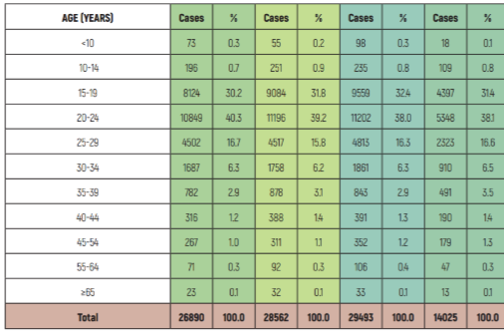
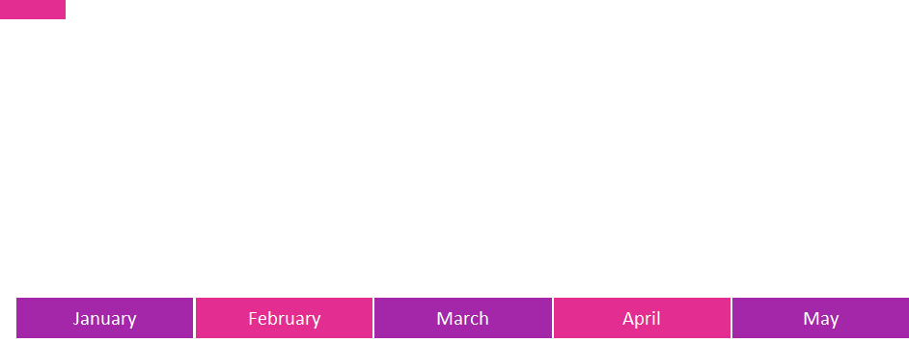
SPARRK-12
Tejas Dinesh, Aleah Brown, Clayton Lawing, Camille Howarth
Alabama Campaign for Adolescent Sexual Health
Project Activities
Evidence of Need
Intended Outcomes
Sustainability
Part 1: Surveys
We intend to send out two surveys as a means to create a sexual health education curriculum that is more comprehensive in nature, while conforming to state law and teachers’ comfort levels in teaching the material. The first survey will be sent to UA students in an attempt to understand what was and what wasn’t taught to them about sexual wellness in class prior to
college. By classifying the results as ‘in-state’ vs ‘out of state’ we hope to better understand where Alabama students stand in relation to other students in regards to understanding the full consequences of sex/how to prevent negative consequences of sexual activity. We also want to collect data on what students wish they’d been taught about sexual health and relationships prior
to college. At the same time, we want to send surveys to teachers and school board members in Tuscaloosa county in order to understand what schools are and are not willing to teach in class regarding the aforementioned topics.
Part 2: Curriculum Building
We will analyze our survey results and work with faculty from UA’s college of education in order to create a novel curriculum that balances the need for more comprehensive sex education curriculum with community/school standards and Alabama law.
Part 3: Teacher Workshop
We will host a workshop for teachers in Tuscaloosa to look at the curriculum and offer suggestions/voice concerns. The curriculum will be updated throughout the process, until it is deemed satisfactory to a majority of those present
Part 4: Submit Final Curriculum to Alabama Campaign
We will make the revisions suggested at the workshop. Once the revisions are complete, the curriculum will be sent to the Alabama Campaign for use/distribution.
Only 24 states mandate sex education to public school children, and only 20 states stipulate the curriculum must be medically, factually, or technically accurate (4). Under current Alabama law, sexual education is neither mandatory, nor must information that is taught be medically accurate. This leads to misleading, limited curriculums that are not in line with recommended evidence-based practices (see key statistics for the results of this). In order to rectify this, SPARRK-12 seeks to create and help implement a more comprehensive sexual education curriculum, while factoring in community input to adhere to social and legal standards in the state.
1)Expand awareness of STI/teen pregnancy rates and remedy the shortcomings of Alabama’s current model of sexual education
2)Produce model sexual education curriculum for use statewide in Alabama.
3)Implement curriculum in participating schools
4)Offer curriculum as a resource through Alabama Campaign
The sustainability of this project lies in the curriculum it produces; that is, a curriculum which simultaneously respects legal/community standards in the state, while offering a more comprehensive education on sexual health and wellness for its high school students. In order to ensure the utility of such a curriculum, teachers and school officials from around the state will provide feedback at every step of the curriculum-building process. When our project is completed in April 2020, this resource will be available through the Alabama Campaign and disseminated through the teachers who helped create it.
Key Statistics
In the first half of 2019 in Alabama, there have been 26,890 cases of chlamydia; Tuscaloosa county accounted for 1,603 of them, comprising 56.2% of the cases in the West Central District
In 2017 in Alabama, there were an estimated 5,922 teenage (age 10-19) pregnancies
A woman who had a teenage pregnancy is more likely to not seek maternal healthcare, drop out of school, not receive higher education in her lifetime, all which affect her employment opportunities for the rest of her life (5)
Alabama Chlamydia Report
Bibliography
Project Timeline
Stanger-Hall, Kathrin F, and David W Hall. “Abstinence-Only Education and Teen Pregnancy Rates: Why We Need Comprehensive Sex Education in the U.S.” PloS One, Public Library of Science, 2011, www.ncbi.nlm.nih.gov/pmc/articles/PMC3194801/.
“The State of STDs in 2017.” Centers for Disease Control and Prevention, Centers for Disease Control and Prevention, www.cdc.gov/std/stats17/infographic.htm.
Alabama Department of Public Health. “Alabama STD Reports- January to June 2019.” ADPH, http://www.alabamapublichealth.gov/std/assets/stdreport_january-june2019.pdf
“State Policies on Sex Education in Schools.” National Conference of State Legislatures. 21 March 2019, http://www.ncsl.org/research/health/state-policies-on-sex-education-in-schools.aspx#2
Build
Curriculum
Submit
Curriculum
Survey
Phase
Teacher
Workshop

