Slide 1
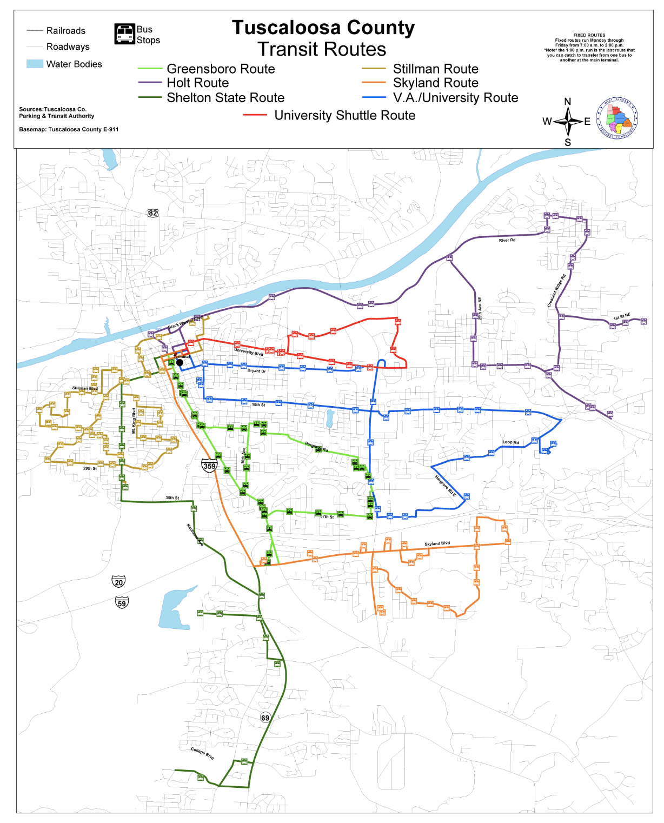
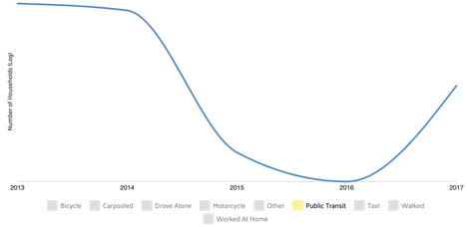
Group IX
Royce Dickerson, Ben Leonard, Kelsi Long,
Zac Pate, and William Roberts
Alabama Transportation Policy Research Center
Project Activities
Evidence of Need
Intended Outcomes
Sustainability
Working with the Alabama Transportation Policy Research Center, Group IX, and the Blackburn community, will gather county constituents and relevant stakeholder groups to present a whitepaper to the Tuscaloosa County Commission that makes the case for applying for a 5311 grant. Using the whitepaper and other briefing materials, Group IX will then make a presentation to the Probate Judge and County Commission. In the presentation, Group IX will argue that this investment of time and money can improve the livelihoods of many of their constituents.
We will have students in the Blackburn class participate in a “rural living simulation” where they will be tasked with planning an entire day using only public transportation. Key partners for this simulation would include groups such as the West Alabama Chamber of Commerce, the University of Alabama’s Center for Service and Leadership, the Alabama Transportation Institute, the Tuscaloosa Transit Authority, and the West Alabama Regional Commission, to ensure its success. Helping to incorporate the entire class, and give a personal account to many of these issues.
For far too many people in Alabama transportation is a major headache. Getting back and forth to work, getting your children home for school, getting groceries to cook dinner, all of these actions require some type of mobile transportation to complete; for many of us, these daily tasks are becoming harder and harder to accomplish. These task are even significantly harder for rural residents in Tuscaloosa County. Day after day they have an even more difficult time accomplishing these tasks and navigating around their community.
At the completion of our white paper presentation the County will have a both factual and personal look at the necessity of public transportation in the rural areas of Tuscaloosa County, and have a realistic path forward for applying for the 5311 grant.
\
Our hope, is that working with this variety of different organizations all across Tuscaloosa County, Western Alabama, and Central Alabama the Tuscaloosa County Commission will see the great evidence for need in the public transportation sector in our rural communities through the facts we have found and real life scenarios we are able to conduct.
Tuscaloosa County has not applied for 5311 funding since the early 1970’s, leaving millions of federal dollars on the table and thousands of residents without food on theirs, due to it being sometimes inaccessible. This white paper, when presented to the Tuscaloosa County Commission and Probate Judge, will consist of the facts and data on the necessity for greater public transportation in rural areas.
Our hope is that through these presentations the county will agree to apply for the funding and then buy demand response vans to operate in rural areas of Tuscaloosa County. The demand for public transportation is on the rise, as shown in Figure 2, and Tuscaloosa County can get ahead of other communities in our state and our region by addressing this issue head on.
The Alabama Transportation Institute, the Tuscaloosa County Commission, and the Tuscaloosa Transit Authorities are established organizations and governmental entities, making this project sustainable into the future and allowing for greater study into the rural transportation issue specifically in Tuscaloosa County going forward. If the County Commission decides to apply for 5311 funding, it will be up to the Commission to draft a proposal to the Federal Transit Administration. And, if the funding for the vans is received, the Commission will likely give the money to the Tuscaloosa Transit Authority, the organization that would operate the vans.
If successful, the “rural living and public transportation” simulation provides another sustainable program going forward that can be used and replicated by the Center for Service and Leadership, Blackburn Institute, or other University organizations that wish to give students valuable experiential knowledge on some of the hardships of living in a rural area of Tuscaloosa County.
Group IX, working with such a diverse group of organizations, provide a long term and sustainable path forward long after the funding is hopefully applied for and obtained by the County.
Group IX, Along with the Blackburn class, and greater Blackburn community, will plan a “rural living simulation” to greater understand the life of those who rely on public transportation as their only means for transit.
5311 funding was enacted to encourage safe and effective public transportation to rural areas. Helping provide funds to alleviate some of these needs.
Figure 1
Currently, we do not have a public transportation system that expands beyond the City of Tuscaloosa (see Figure 1). Citizens living in the rural areas of Tuscaloosa County are without an affordable transportation method. Demand has risen over the past two years for public transportation systems because citizens, at the moment, are burdened with the cost of purchasing a vehicle, maintaining the vehicle as well as affording gas that is continuously rising, especially after the recent passage of the gas tax in Alabama.
Between 2015-2017 there has been an 18% increase in the public's demand for public transportation, and as the counties population continues to expand and include more people to service, that demand will only increase.
The city has done a good job in providing some options to lower income residents in getting around the city in public transportation, but these routes do not go to many skilled labor worksites or serve residents in rural Tuscaloosa County.
Tuscaloosa County has a walkability score of 33. In comparison, Charleston, South Carolina has a walkability score of 4o and New York City has a walkability score of 89.
Figure 2
Bibliography
Tuscaloosa neighborhoods on Walk Score. (n.d.). Retrieved from https://www.walkscore.com/AL/Tuscaloosa.
Tuscaloosa County, AL. (n.d.). Retrieved from https://datausa.io/profile/geo/tuscaloosa-county-al.
Palmer, V. J. (n.d.). Tuscaloosa County Route Information . Retrieved from http://www.tuscaloosatransit.com/routeInfo.php.

