Slide 1
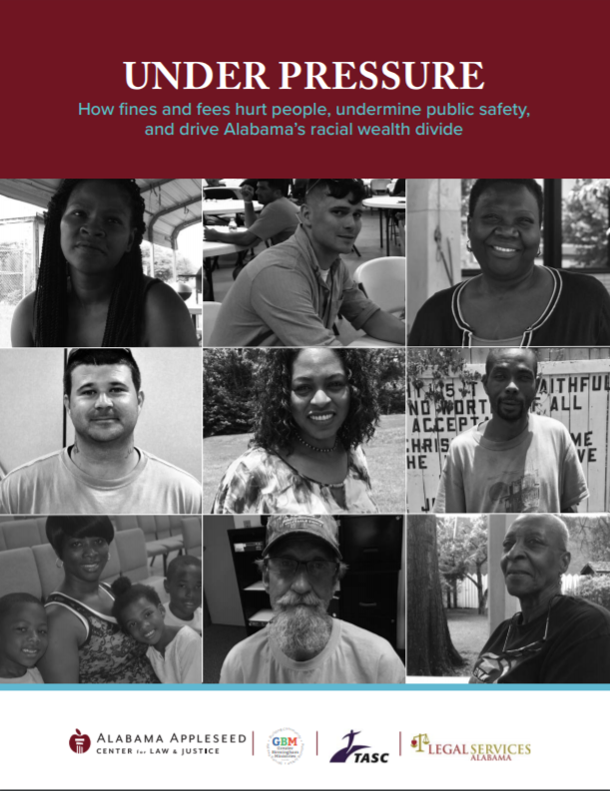
Under Pressure
How Fines and Fees hurt people, undermine public safety, and drive alabama’s racial wealth divide

Slide 2
What is the racial wealth gap?
Wealth is a measure of the totality of what a person owns minus any debt they own. Even two people who have the exact same income can have very different amounts of wealth depending on factors like inheritance and debt.
In Alabama and across America, there is a wealth gap between black and white populations.
In 2011, a typical white family in America in the bottom income quintile (earning less than $19,000 annually) owned $15,000 in wealth. A typical African-American family earning the same amount owned just $100 in wealth.
Due to the difference in median household net worth between the races, the median Latino or black household would have to save nearly 100% of its income for at least three consecutive years to close the gap.
Looking at overall household wealth, African-American families have a nationwide median of $11,000 in net worth compared to $134,000 held by white families.

Slide 3
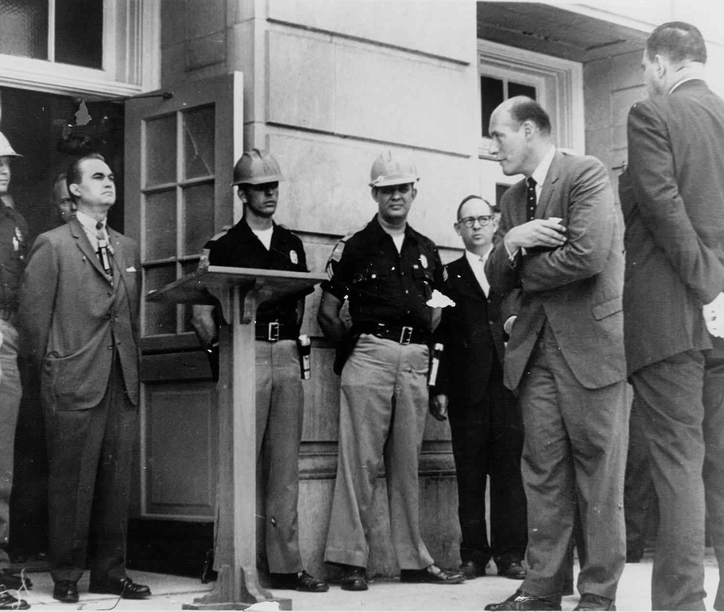
Historical Causes of Alabama’s Racial Wealth Gap
Slavery
Convict labor, which led to the effective re-enslavement of black people who were accused of minor crimes like panhandling.
Redlining and local ordinances that made it impossible for black families to buy homes in nice neighborhoods and accumulate wealth through home equity added to the problem.
Segregated schools and the creation of majority-white and wealthier city school districts in the wake of Brown v. Board
The exclusion of black people from universities and high-earning professions.

Slide 4
How the Criminal Justice System Drives Alabama’s Racial Wealth Gap
African Americans make up 54% of the prison population but only about 27% of the state’s population. They are over-represented in jails at roughly the same rate.
In 2016, African Americans were more than twice as likely as white people to be arrested for six of the 20 charges for which the most people were arrested that year.
Black people were four times as likely as white people to be arrested for possession of marijuana even though there is longstanding evidence that the two races use marijuana at about the same rate.
Several other offenses with major disparities hinge on the perception of the arresting officer and are also cause for concern.
African-Americans were 3.7 times as likely as white people to be arrested for disorderly conduct in 2016;
2.3 times as likely to be arrested for trespassing (which can include remaining in public accommodations like restaurants after being asked to leave)
Twice as likely to be arrested for resisting an officer and contempt of court in 2016.

Slide 5
We surveyed people all over Alabama about their experience with court debt.

Slide 6
Most of the people we surveyed were poor. Black or white, all were suffering from the effects of fines, fees, and court costs.
Almost 7 in 10 had at some point been declared indigent in court and had counsel appointed because they were too poor to afford it.
Close to 2/3 did not have a bank account.
More than half were unemployed.
Almost half said they’d have no money to get out of jail if they needed it that day.
Almost half said they didn’t think they would ever be able to pay what they owed.

Slide 8
Findings
More than eight in ten (82.9%) gave up necessities like rent, food, medical bills, car payments, and child support to pay their court debt.
Nearly half (49.6%) said they had been jailed for failure to pay court debt.
44% had used payday loans to cover court debt.
Eight in ten borrowed money from a friend or family member to cover their court debt.
Almost two-thirds (65.9%) received money or food assistance from a faith-based charity or church that they would not have had to request if it were not for their court debt.

Slide 9
Findings
Almost four in ten (38.3%) admitted to having committed at least one crime to pay off their court debt, including almost one in ﬁve (19.6%) whose only previous offenses were traffic violations. The most common offense committed to pay off court debt was selling drugs, followed by stealing and sex work. Survey respondents also admitted to passing bad checks, gambling, robbery, selling food stamps, and selling stolen items.
Almost half (48%) did not think they would ever be able to pay what they owe.
Nearly the same number (48.7%) said they would have no money to get out of jail if they needed it that day.
The median amount owed was $2,700, and the mean was $6,536.

Slide 10
More Findings
About 45 percent of those surveyed had lost their licenses because they were unable to pay their court debt.
Many people owed money in several different jurisdictions. Those jurisdictions do not talk with each other. It was common for people to be on payment plans in several cities and counties.
Lots of people talked about being locked up for failing to appear at hearings on their non-payment of court debt even though they missed the hearings because they were already in jail or prison.
We also learned about DART teams, or District Attorney Restitution Recovery Teams, which increase people’s debt by 30% when they who get behind on payments. The teams then keep that 30% off the top of anything they collect.

Slide 11
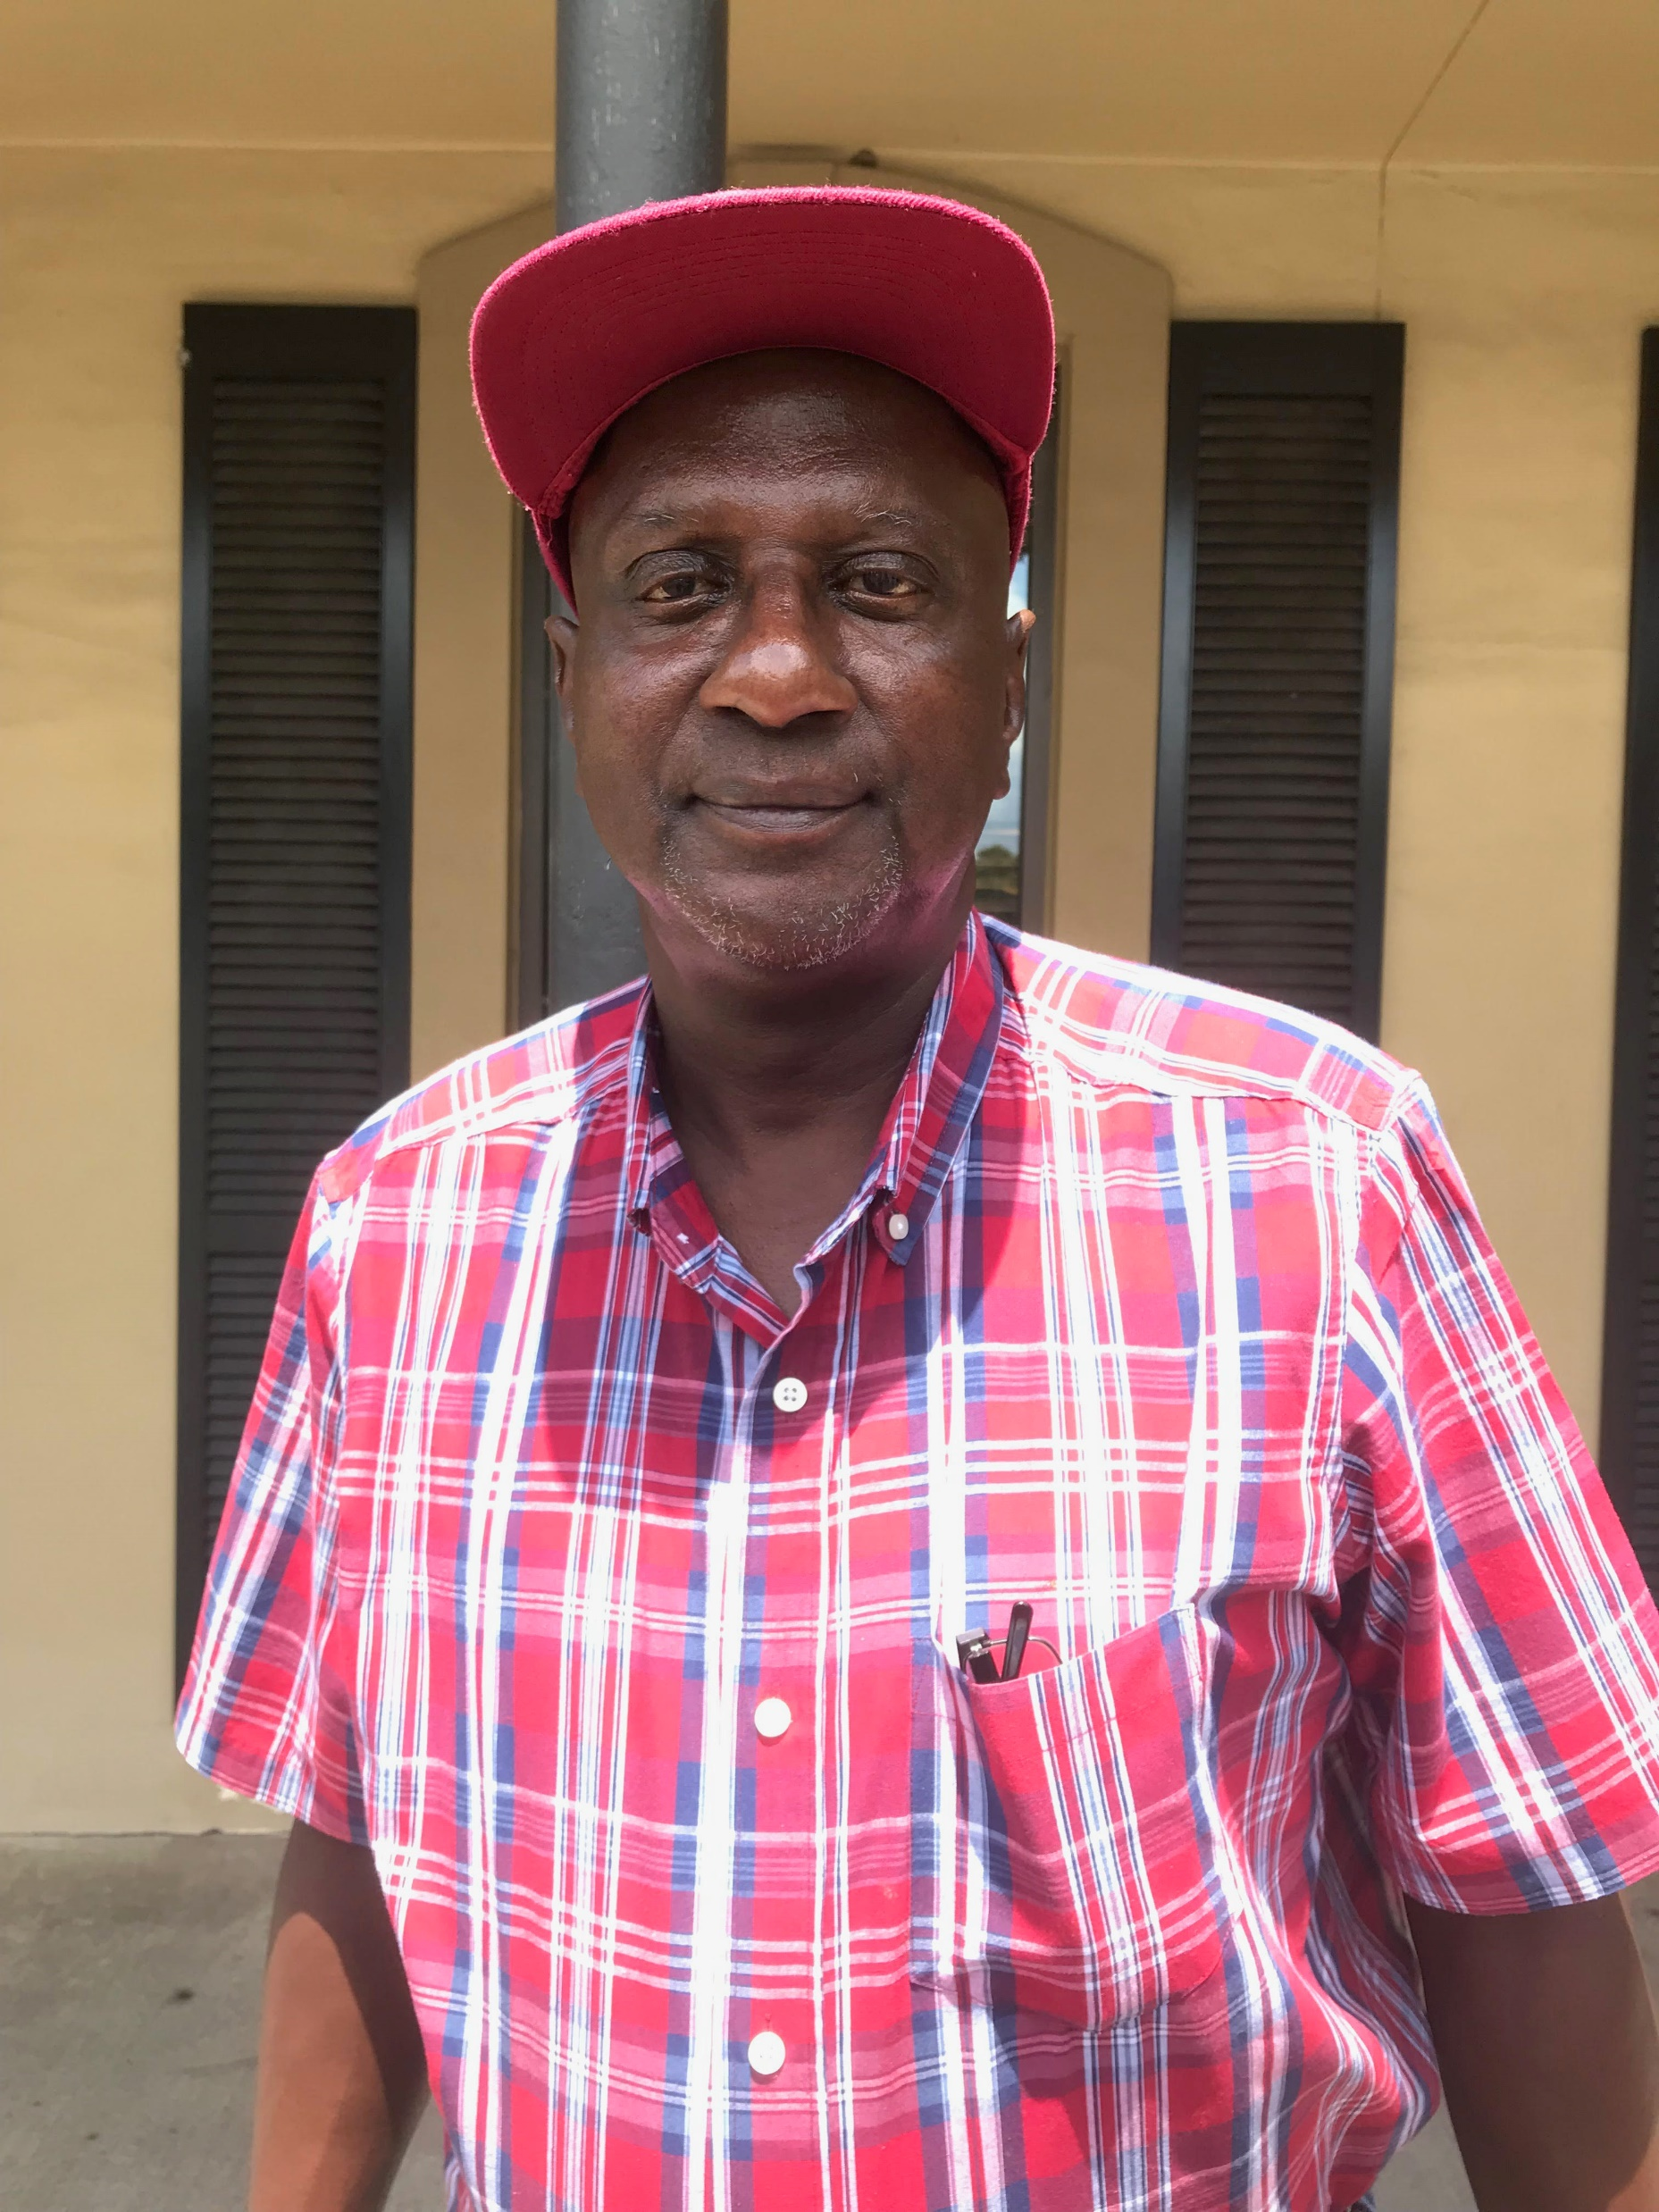
Voting Rights
Under a 2017 state law, people with certain felony convictions are prohibited from registering to vote unless and until their court debts are paid off. More than half (55.7%) of people we surveyed had been told they could not vote because of a felony conviction.
Mr. Robert Peoples of Grand Bay is one of 286,000 disenfranchised Alabamians. His voting rights were taken in 1996 due to a Theft of Property II conviction. He cannot afford the $332 required to buy his voting rights back.

Slide 12
Recommendations
Eliminate court costs and fees and scale fines to each person’s ability to pay
Fully fund courts from Alabama’s state budget
Send revenue from all court debt to the state’s general fund
Create a mechanism for appeal and ensure folks have access to counsel throughout the process
Prohibit the suspension of driver’s licenses except in instances of unsafe driving
Eliminate Failure to Appear warrants when the individual failed to appear because they were incarcerated
Change the law that currently denies voting rights to people who are too poor to pay their court debt
Reclassify the possession of small amounts of marijuana as a civil infraction with fines connected to the defendant’s ability to pay

