Slide 1
Expanding Access to Civil Legal Services for Rural and Under-Served Populations in Alabama
Access to Justice:
Blackburn Institute Annual Symposium
August 24, 2019

Slide 2
Farah Majid Coordinating Project Attorney Legal Services Alabama
Blackburn Institute Annual Symposium
August 24, 2019

Slide 3
Expanding Access to Civil Legal Services for Rural and Under-Served Populations in Alabama
Access to Justice:
Blackburn Institute Annual Symposium
August 24, 2019

Slide 4
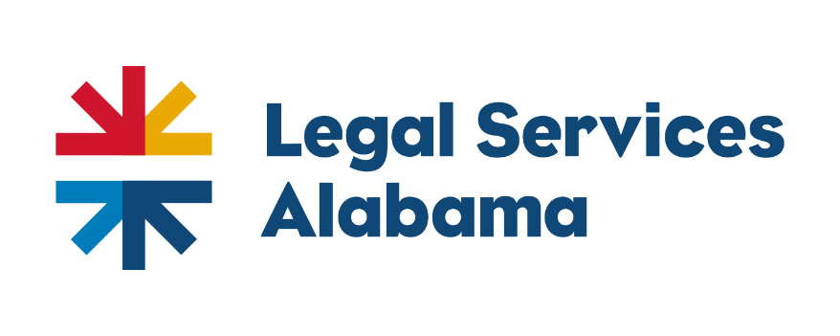
The Rural Economic Improvement Project
Farah Majid
Coordinating Project Attorney

Slide 5
The State

Slide 6
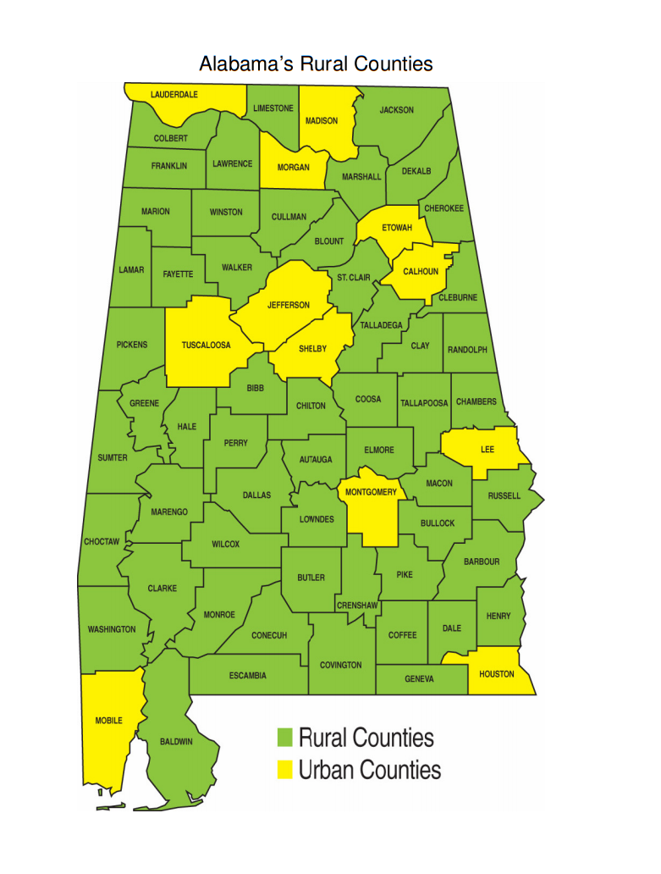

Slide 7
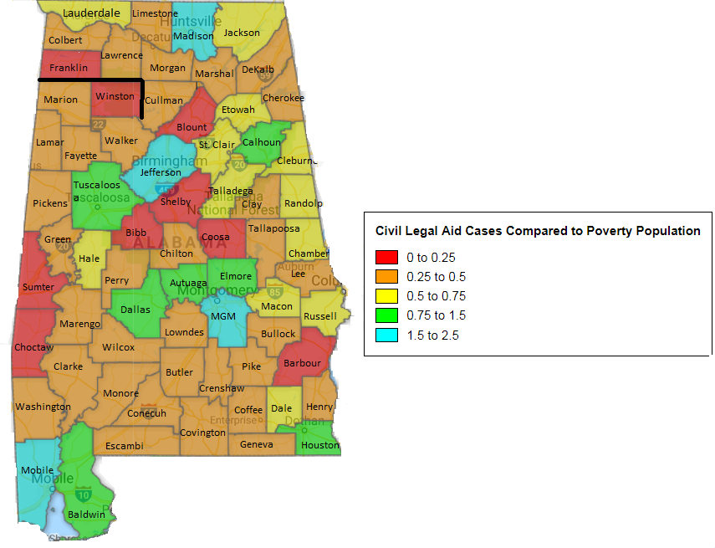

Slide 8
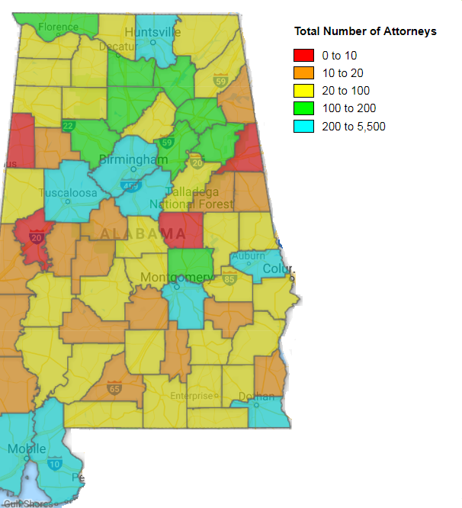

Slide 9
Utilizing Non-Lawyers

Slide 10
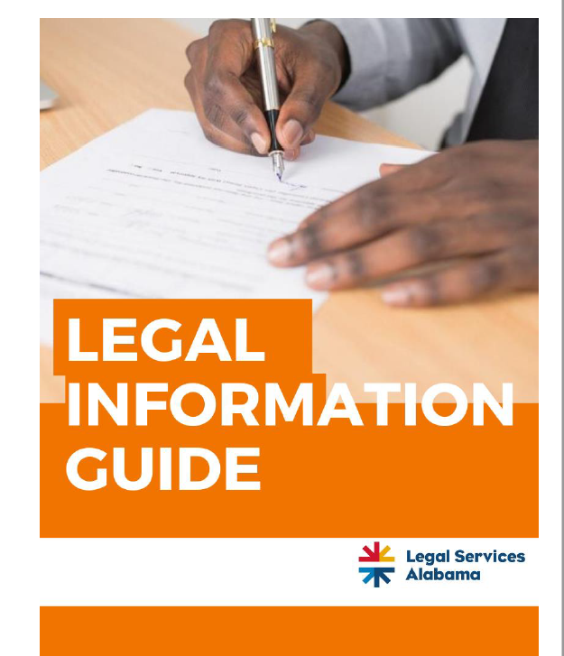
Utilizing Non-Lawyers
Service providers
Public libraries
Self-help center

Slide 11
Going Where the Clients Are

Slide 12
Black Belt Specific Initiatives
Alabama’s Black Belt
Lawyer for a Day clinics
Office hours in rural counties
Community partnerships
Bankruptcies
Notes:
According to the 2010 Census data, Wilcox County had the highest poverty rate of any county in the state and nation – nearly 40 of every 100 people live in poverty.

Slide 13
Discovering Solutions

Slide 14
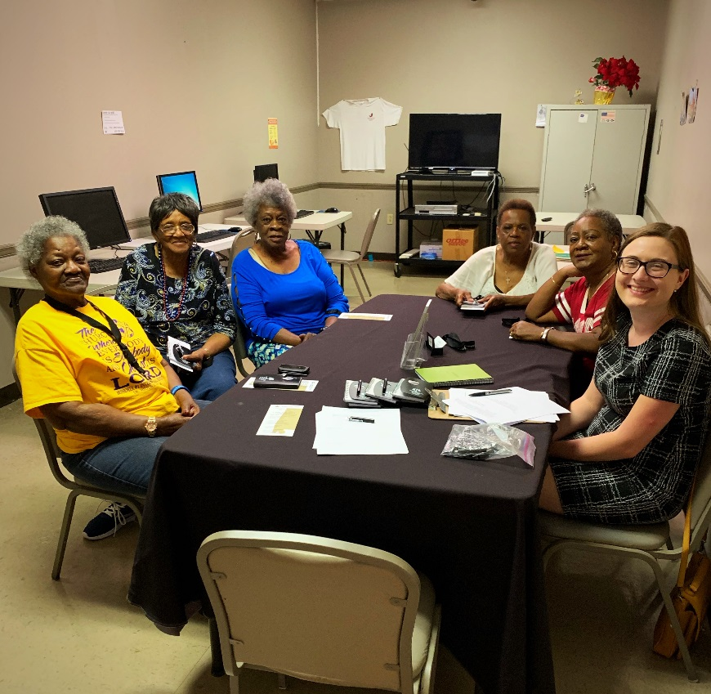
Listening Sessions
Listening sessions around the state with communities
Partnership with Alabama Appleseed – in-depth listening sessions in the Black Belt

Slide 15
Other Innovations

Slide 16
Tele-Legal Services
Partnership with AIDS Alabama Outreach
Using existing tele-medical technology

Slide 17
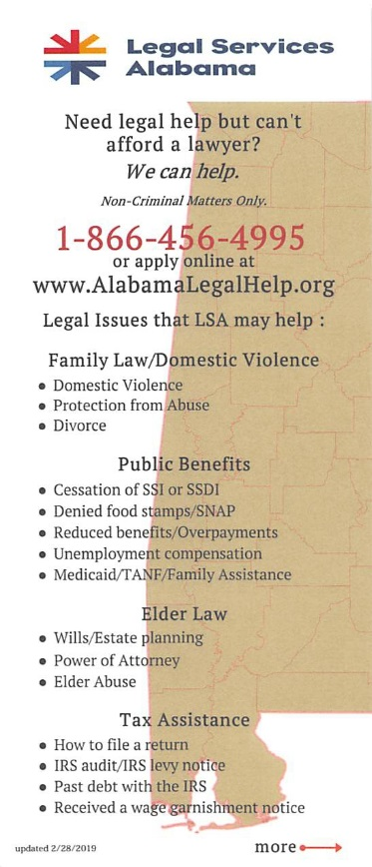
Outreach to Judges/Clerks
Tracking results
Case advocacy in rural counties/problem areas

Slide 18
Questions?
Farah Majid
Rural Economic Improvement Project
Coordinating Project Attorney
(205) 328-3540 ext. 3515
fmajid@alsp.org

Slide 19
Steve Rygiel Director of the Legal Program Birmingham AIDS Outreach (BAO)
Blackburn Institute Annual Symposium
August 24, 2019

Slide 20
Blackburn institute symposium August 24, 2019
Access to Justice:
Expanding Access to Civil Legal Services for
Rural and Underserved Populations in Alabama
Stephen D. Rygiel, Esq.
Director of the Legal Program
Birmingham AIDS Outreach (BAO)
steve@birminghamaidsoutreach.org
https://www.birminghamaidsoutreach.org

Slide 21
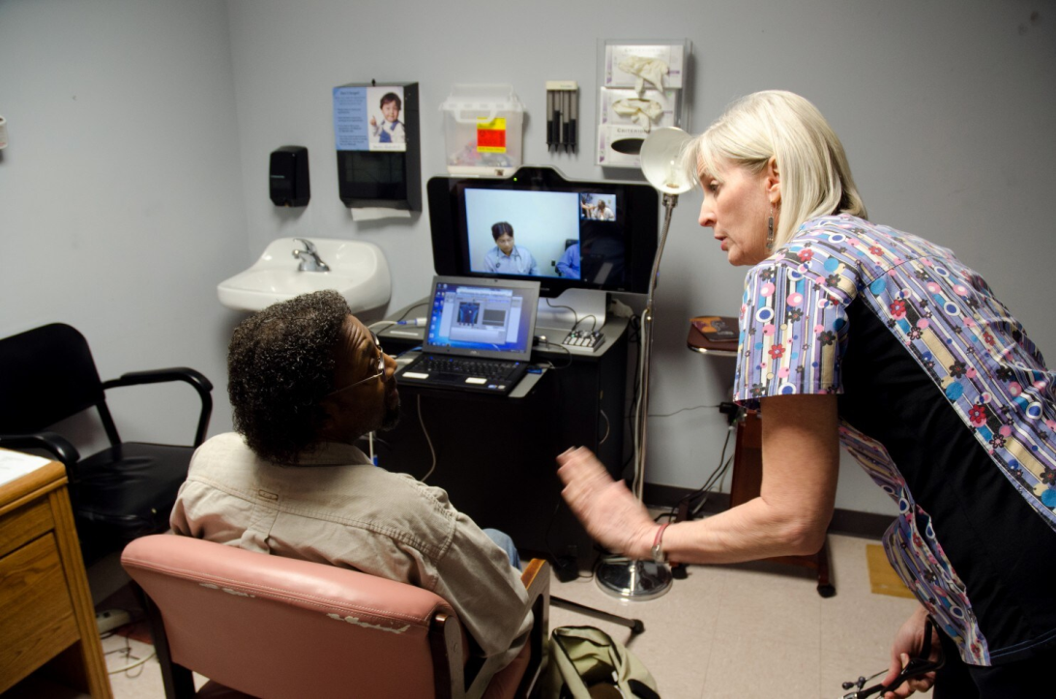
The South is the epicenter of new HIV infections in the United States (Washington Post, 7/20/2012)
HIV patient Michael Young talks via a telemedicine hookup with Dr. Prashanth Bhat. Nurse Diane Weil looks on. Young was in a clinic in Selma, Ala., and Bhat was 50 miles away in a clinic in Montgomery, Ala. on July 12, 2012. The telemedicine program is an innovative effort to give HIV patients in the state better access to better care. (David Kohn/For The Washington Post)
Source: By David Kohn, July 20, 2012
https://www.washingtonpost.com/postlive/the-south-is-the-epicenter-of-new-hiv-infections-in-the-united-states/2012/07/20/gJQA70Z6xW_story.html

Slide 22
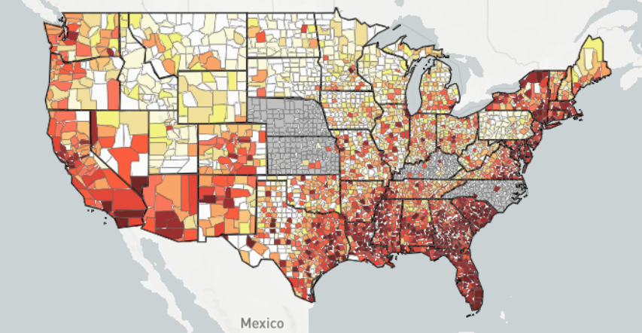
AIDSVu is an interactive online mapping tool that visualizes the impact of the HIV epidemic on communities across the United States. https://aidsvu.org/
Source: https://map.aidsvu.org/map

Slide 23
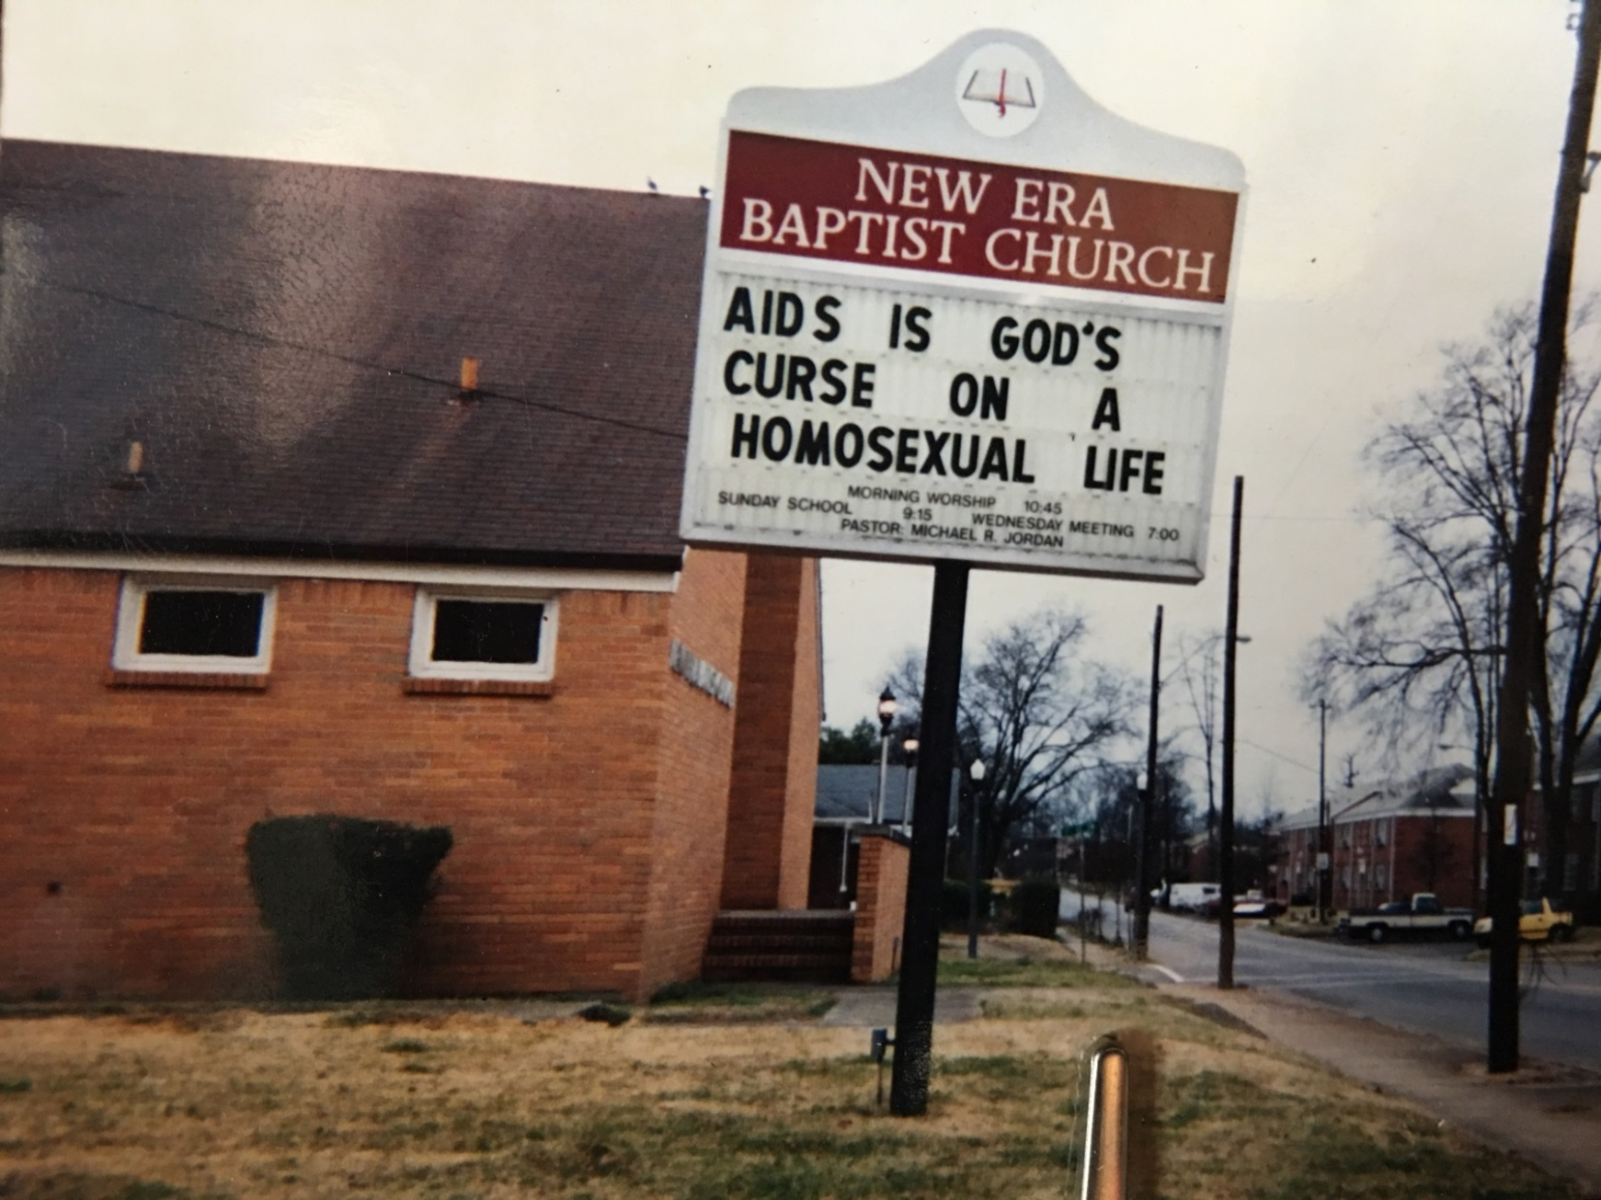
Role of Stigma in Access to Services

Slide 24
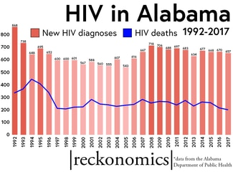
Medical advances still haven’t stopped HIV epidemic in Alabama (al.com, 8/11/2019)
“Despite the medical advances and networks of care, the rate of new infections
every year in Alabama has barely budged over the last two decades, according to the Alabama Department of Public Health. […] And those unflinching numbers – particularly in rural areas – are the reason Alabama is now being targeted by a national health initiative.”
Source: https://www.al.com/news/2019/08/medical-advances-still-havent-stopped-hiv-epidemic-in-alabama.html

Slide 25
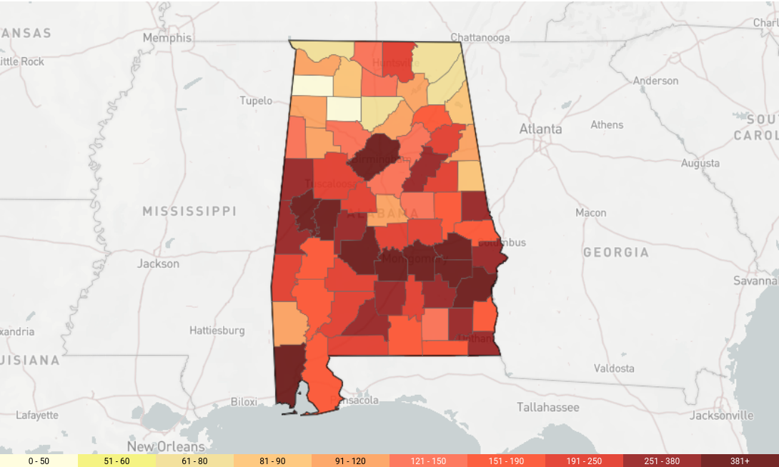
Providers want to find and stamp out HIV in rural Alabama (al.com, 8/12/2019)
Source: https://aidsvu.org/state/alabama/
Source: https://www.al.com/news/2019/08/providers-want-to-find-and-stamp-out-hiv-in-rural-alabama.html

Slide 26
BAO Services & Programs
HIV/STD/STI Testing
Food Bank
Nutritional Supplements
Food Vouchers
Clothing Closet
Household Items
Transportation
Medication Assistance
Medical Supplies
GED Classes
Personal Hygiene Items
Case Management
Pet Food/Spay/Neuter
Community Events
*Legal Services*
Counseling
Support Groups
HIV Education and Prevention
Hep C Outreach Testing
Couples Counseling and Testing
Patient Navigation for Newly Diagnosed
Youth Advisory Council
Junior Board
Brother to Brother
Birmingham Access to Care
Medical Support Services with UAB
Community Calendar

Slide 27
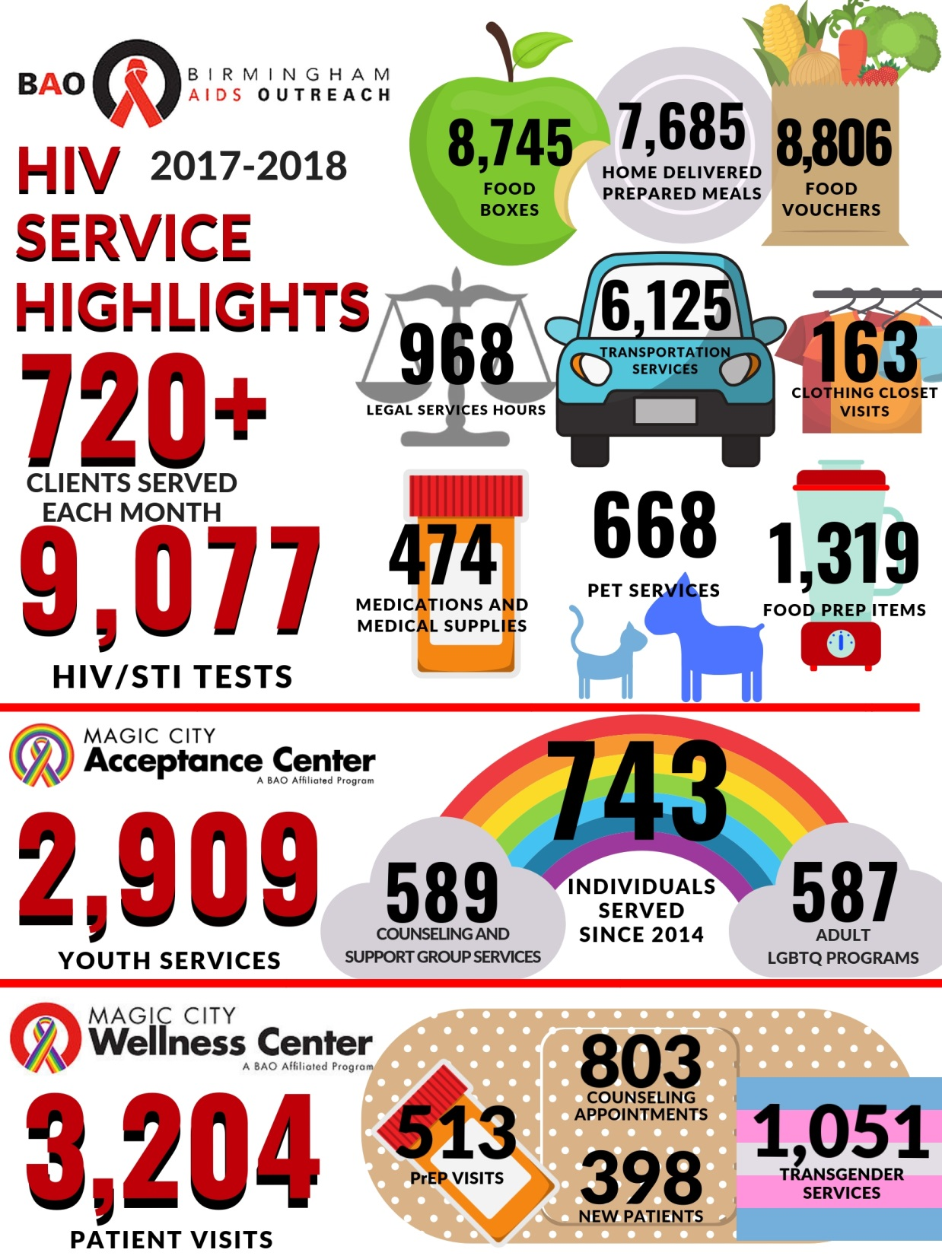

Slide 28
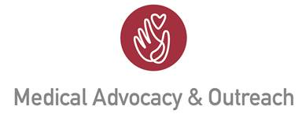
Grant Partnerships to Expand Access
Birmingham AIDS Outreach (BAO), Birmingham
https://www.birminghamaidsoutreach.org/
Medical Advocacy and Outreach (MAO), Montgomery
http://maoi.org/
MAO Telehealth Resource Center, Montgomery
http://maoi.org/get-connected/telehealth-resource-center/
Financial Support
AIDS United https://www.aidsunited.org/
Elton John AIDS Foundation http://ejaf.org/
AL Civil Justice Foundation http://www.acjf.org/

Slide 29
BAO Pro Bono Legal Services
Public Benefits Planning (Social Security disability, food stamps, other public assistance programs)
Lesbian-Gay-Bisexual-Transgender-Queer+ (LGBTQ+) rights
Discrimination (employment, housing, insurance)
Future/Estate Planning (Last Will and Testament, powers of attorney, advance directive for health care)
Probate Law (probate estate issues, name changes, gender marker changes, restoration of voter rights, guardianships and conservatorships)
Breaches of Privacy and Confidentiality
Consumer Law Issues (debt collection, financial exploitation, identity theft, etc.)
Family Law/Domestic Relations
Prisoner’s Rights and Criminal Justice Issues pertaining to LGBTQ+ or HIV status

Slide 30
MAO’s Alabama e-Health Program: Transcending Barriers of Rural Healthcare
MAO operates a state-of-the-art telemedicine network consisting of two full-service provider locations in Montgomery and Dothan, a third in development, and 10 rural patient satellite clinics that represent MAO’s Alabama e-Health Initiative. Patients benefit from direct care as well as counseling and social service assistance via Alabama e-Health.
Alabama e-Health Satellite Clinics:
Barbour County – Clayton
Escambia County – Brewton
Conecuh County – Evergreen
Covington County – Andalusia
Henry County – Abbeville
Marengo County – Linden
Lowndes County – Hayneville
Dallas County – Selma
Perry County – Marion
Pike County – Troy
Source: http://maoi.org/get-care-support/alabama-e-health-telemedicine/

Slide 31
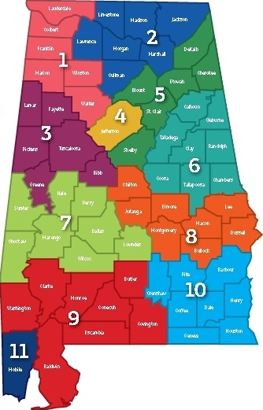
Formation of a telemedical-legal partnership for increasing access to health and justice in Alabama. Rygiel, S.D., Evans, S., Musgrove, K., Murphree, M., & Batey, D.S. Medical Advocacy and Outreach of Alabama; Birmingham AIDS Outreach; University of Alabama at Birmingham; AIDS United
Background and Scope of Need
Alabama Public Health Areas
Developmental Steps
Alabama ranks historically poor across all measures of poverty and currently has the fourth highest poverty rate in the United States. Approximately 19.2% of Alabamians—over 900,000 men, women, and children—live below Federal Poverty Line.
The need for pro bono legal services in Alabama is critically dire; in 2015, over 422,000 households experienced 733,000 legal issues with low-income households only having had legal assistance for approximately 16% of these legal problems.
The poor face innumerable and multi-layered barriers when seeking access both to healthcare and access to justice in Alabama, where extreme poverty drives the HIV/AIDS epidemic in rural geographical areas of high need with scarce medical and pro bono legal resources. As of 12/31/2016, Alabama reports 13,487 diagnosed HIV infections, the majority of which involve low income status and frank poverty.
Each day, countless impoverished, underserved, and oppressed Alabamians experience profoundly adverse health and legal outcomes that are largely preventable, including racially and socio-economically disparate health deficits, erosion and/or forfeiture of legal rights, and even morbidity.
With funding from AIDS United, Medical Advocacy and Outreach of Alabama (MAO) established the “Alabama eHealth” telemedicine program through the launching of its first remote-access medical clinic in Selma, Alabama, in 2011, to serve people living with HIV/AIDS in rural southern Alabama. Growing from one patient clinic and one provider location, MAO subsequently has expanded its telemedicine network consisting of 2 provider locations and 10 rural patient clinics across 4 Public Health Areas.
Also with funding from AIDS United, Birmingham AIDS Outreach (BAO) first opened its pro bono “Aiding Alabama” legal program in 2006, and has been funded by AIDS United since then. This one of a kind program is available to all of Alabama, Aiding Alabama provides free legal services to people infected/affected by HIV/AIDS primarily living in Public Health Area 4 with a range of areas of law practice, including but not limited to: public benefits planning; future/estate planning; health care access; discrimination in housing, insurance, and/or employment; domestic relations and family law; privacy/confidentiality; and probate law.
Partnership
Activities to Date
Medical Advocacy and Outreach of Alabama (MAO) hosts the nationally recognized and award-winning “Alabama eHealth” telemedicine program. MAO is located in Public Health Area 8 in the City of Montgomery and serves over 1,600 HIV-positive patients living in 28 counties through 10 rural medical clinic sites primarily served via telemedicine.
Birmingham AIDS Outreach (BAO) hosts “Aiding Alabama,” the sole pro bono legal program in Alabama exclusively serving the legal needs of Alabamians impacted by HIV/AIDS. Aiding Alabama is located in Public Health Area 4 in the City of Birmingham and is available to all 67 Alabama counties.
The Department of Social Work at the University of Alabama at Birmingham provides education, expertise, resources, and training in comprehensive HIV/AIDS case management.
In December 2016, the partners formalized plans to utilize existing telemedical infrastructure specifically to expand the reach and outreach of pro bono legal services into rural areas of southern Alabama. The Alabama eHealth telemedicine program employs high definition cameras and video screens, 128-bit 256-bit!!! encryption, high speed internet and Bluetooth medical technology to enable clinicians in urban settings to treat patients in rural clinics, thereby providing real-time, direct to patient HIV primary care from a distance.
In April 2017, the Alabama eHealth telemedicine program will be installed in the pro bono legal office of Aiding Alabama, and patients in rural southern Alabama soon will begin legal-checkups in addition to medical appointments.
Map by Alabama Department of Public Health (adph.org)

Slide 32
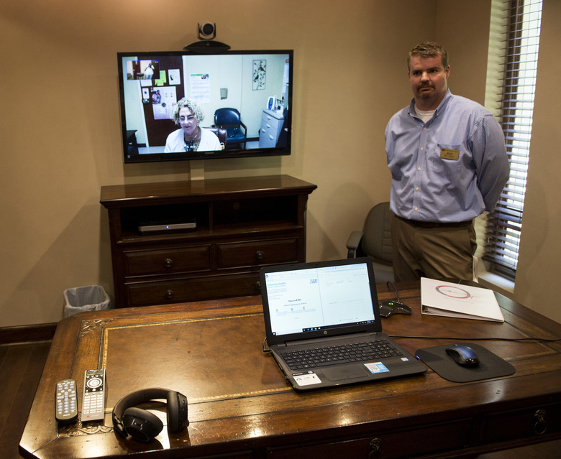
CDC director praises Alabama HIV clinic ahead of campaign (Associated Press, 6/14/2019)
Source: https://www.seattletimes.com/seattle-news/health/cdc-director-praises-alabama-hiv-clinic-ahead-of-campaign/

Slide 33
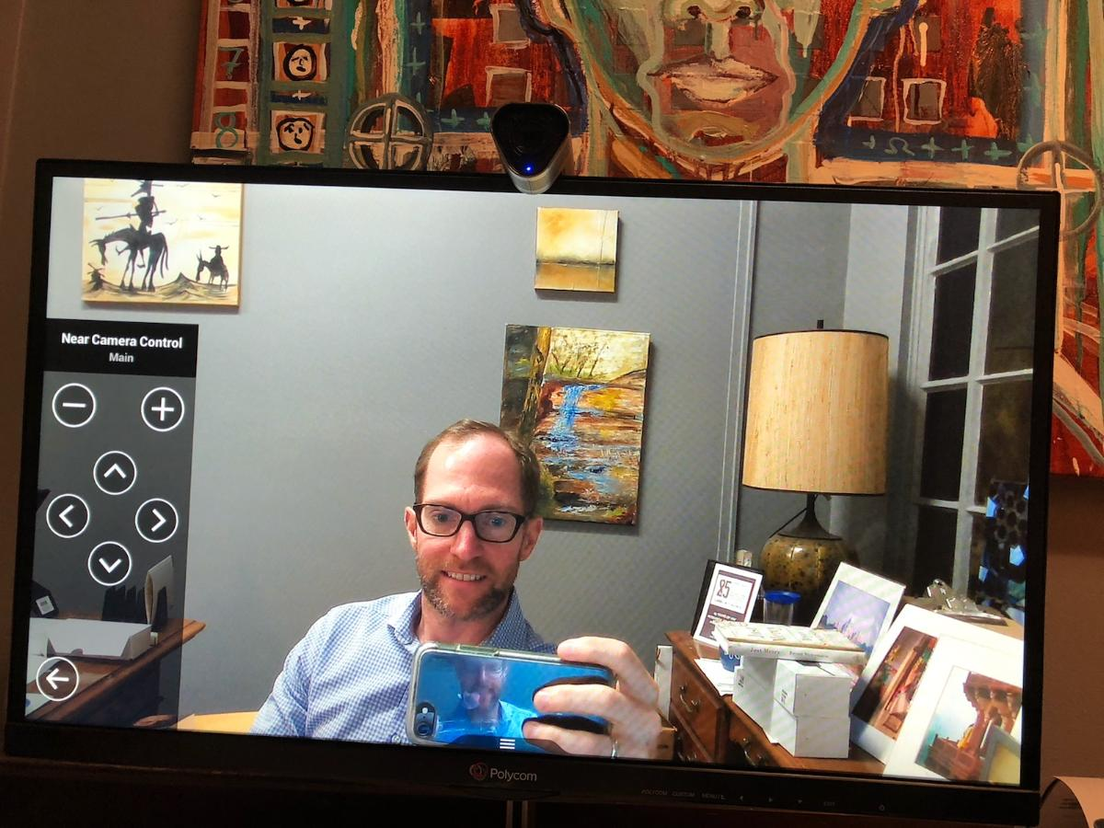
BAO-MAO Telelegal-Telemedical Partnership
Law & Supportive Services
Medicine & Technology

Slide 34
The Honorable Henry A. Callaway Chief U.S. Bankruptcy Judge for the Southern District of Alabama
Blackburn Institute Annual Symposium
August 24, 2019

Slide 35
VIEW FROM THE BANKRUPTCY BENCH Henry Callaway, U.S. Bankruptcy Court for the Southern District of Alabama
Bankruptcy is a pressure relief valve, especially in a state with few consumer protections
Most debtors are making it but encounter a financial obstacle they do not have the resources to overcome – loss of job, divorce, illness
In bankruptcy (oversimplification), a debtor may be able to:
* Get out from most unsecured debt like credit cards and payday loans
* Keep a car by paying value of vehicle over time at
market interest rate
* Stop foreclosure and catch up mortgage in bankruptcy

Slide 36
Title Pawn Loans
Every small town in Alabama has a title pawn store. To a borrower, a title pawn looks like a regular secured loan, but it’s not. Title automatically goes to the pawn company if loan not paid within 60 days. 300% interest allowed. Alabama Code § § 5-19A-1, et seq.
In re Northington, 876 F.3d 1302 (11th Cir. 2017) – Under Georgia law, auto “drops out” of bankruptcy automatically when time to redeem has run. Alabama law is same.
RESULT: Debtor cannot keep auto and pay through chapter 13 plan. Debtors losing vehicles right and left. Bankruptcy is no help.

Slide 37
Too broke to file Bankruptcy?
Chapter 7 – liquidation. $800-$1,500 attorney’s fee, almost always paid up front because all prepetition debts get discharged. 95% discharge rate.
Chapter 13 – wage earner reorganization. Payments to trustee for 3-5 years. Must pay all net income to trustee if not paying 100% to creditors. $4,000 fee paid through plan in S.D. Alabama. About 45% discharge rate in S.D. Alabama. Many dismissals, many repeat filings.
FY 2018 percentage of chapter 13 filings:
National 37.5%
Southern District of Alabama 71.9% (5th in nation)
Middle District of Alabama 77.5% (3rd in nation)
Northern District of Alabama 53.2%
Baldwin 58% Dallas 86% Hale 100% Monroe 82%
Mobile 70% Wilcox 91% Conecuh 91% Perry 83%

Slide 38
Possible Reasons For High 13 rate
Historical – wage earner reorganization originated in Birmingham in 1930’s
Low exemptions in Alabama – for personal property, homestead, and wages (N.D. Florida has 20% chapter 13 rate).
Non-judicial foreclosure in Alabama (< 1 month) – no time to negotiate or save up money for a bankruptcy
Racial disparity
Counsel financial incentive – $800-1500 for a Chapter 7 vs. $4000 no-look Chapter 13 fee in S.D. Ala.
Inability to pay prepetition fees – May 2016 Atlantic magazine article: 47% of all Americans could not come up with $400 in an emergency

Slide 39
Rural access to bankruptcy courts
Not that many rural attorneys in the first place. New lawyers have student loan debt, want larger city amenities.
Relatively small attorney fees, especially for a chapter 7. Only small-type case where you must travel to a federal courthouse located hours away; all debtors and their attorneys must appear for at least one hearing, some for many hearings. Not economical for an attorney to handle 1 or 2 cases.
Increasing complexity of bankruptcy since “reform” in 2005
RESULT: Almost no bankruptcy practitioners outside Mobile, Baldwin, and Dallas (Selma) counties in the 13 counties of the Southern District of Alabama. Six of thirteen counties have no bankruptcy practitioners.
Filing rates per 1000 population – higher in Mobile and adjacent counties, lower in more distant counties
Mobile 7.06 Hale 0.61 Choctaw 3.66
Clarke 6.44 Marengo 3.46 Perry 4.38
Dallas 7.88 (court held in Selma) Wilcox 4.42

Slide 40
WHAT’S COMING/POSSIBLE SOLUTIONS
“Turbotax for chapter 7”?
Courts are rolling out Electronic Self Representation (ESR) modules
www.upsolve.org – self-representation using forms created online
and nonprofit help
Problem: low-income folks access the internet with their phones, not PC’s
Alabama Bankruptcy Pro Bono Project
Pro bono help for chapter 7 debtors (traditionally a hard sell to bankruptcy lawyers)
Program does intake and prepares schedules
Training for non-bankruptcy lawyers
Springboard to encourage more rural lawyers?
Making it easier for rural lawyers/debtors to file chapter 7 cases
Video meetings of creditors (Facetime, Skype)
Telephonic hearings wherever possible
Changing bankruptcy laws to provide for payment of chapter 7 attorney’s fees after filing
“Unbundled” bankruptcy services in chapter 7 (separate pre- and post- bankruptcy contracts)
Title pawns – will require state legislative action

Slide 41
Glory McLaughlin Assistant Dean of Public Interest Law The University of Alabama School of Law
Blackburn Institute Annual Symposium
August 24, 2019

Slide 42
The Finch Initiative

Slide 43
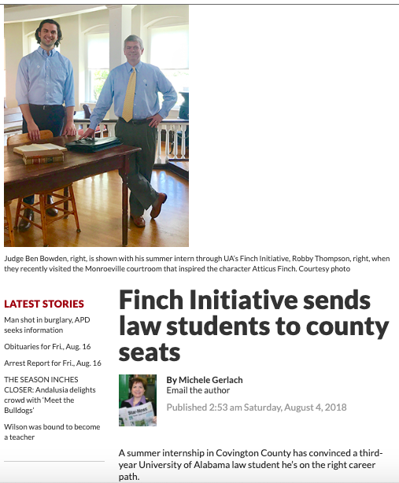
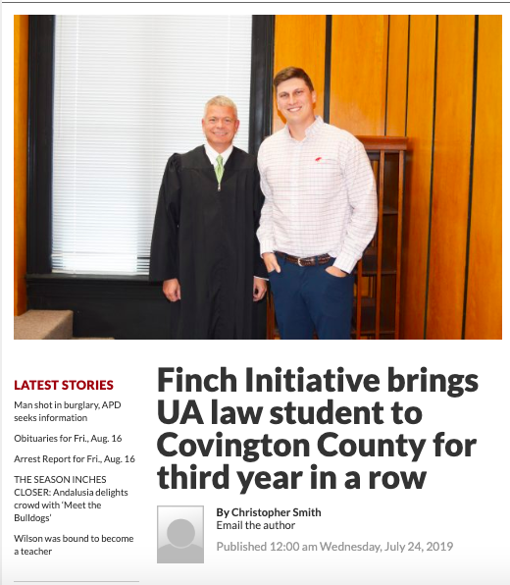
The Finch Initiative
in the News
The Andalusia Star-News, August 2018
The Andalusia Star-News, July 2019

Slide 44
Q&A

