Slide 1





School-Sharing Communities
All the world is a laboratory to the inquiring mind. ~Martin H. Fischer
Identifying and leveraging ALL communities’ most precious assets.
Providing a world-class, career-focused ECE-12 AND postsecondary education/credential.
Defining equity in terms of fairness AND ownership.
Engaging cross-sector partners in catalytic ways.
Empowering youth to engage with and help solve their community’s most stifling challenges.

Slide 2


SCHOOL-SHARING COMMUNITIES
From a class project to a living organization.
School-sharing shifts the burden of education from schools alone to the greater community, engaging citizens and businesses in the great duty and privilege of educating children and preparing our future leaders and workforce.
Educators
Communities/
Private Sector
School-Sharing Communities

Slide 3
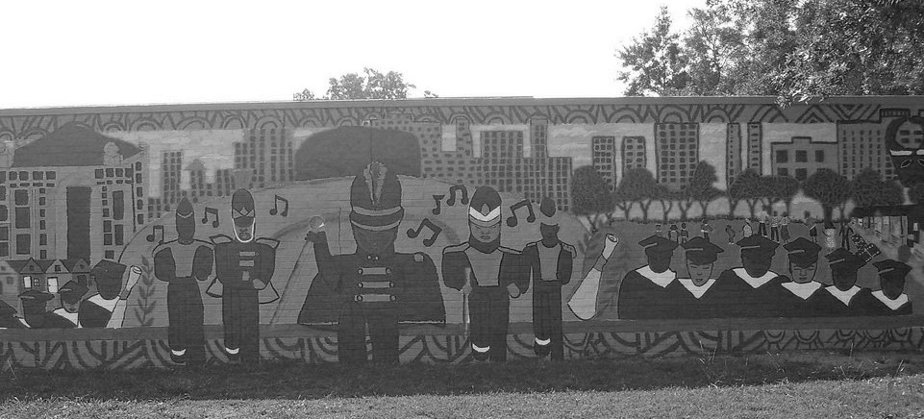


VISION FOR YOUTH AND COMMUNITIES
Build UP empowers and equips youth and communities to determine their future.
Youth
Communities
Gain all the tools necessary to lead successful lives.
Gain a critical mass of effective leaders to direct longer-term community revitalization.

Slide 4
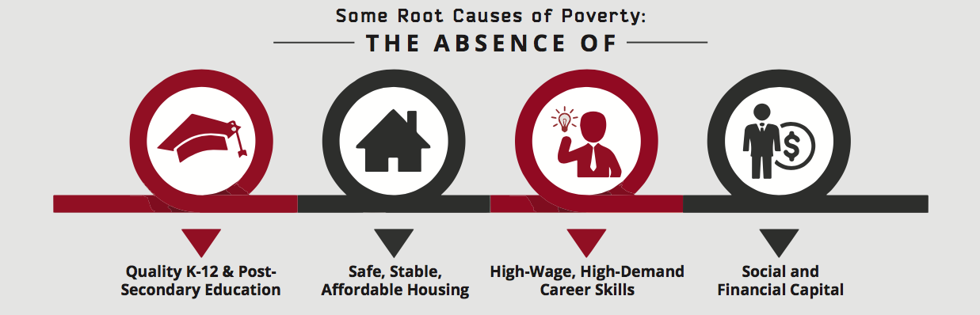
EXISTING SINGLE-SECTOR SOLUTIONS ARE FLAWED
Addressing one aspect of poverty at a time does little to change it.

Slide 5
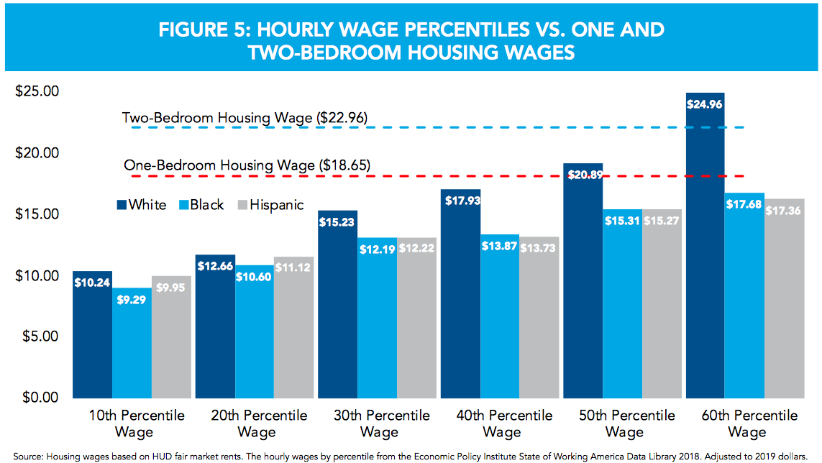
EXISTING SINGLE-SECTOR SOLUTIONS ARE FLAWED
Addressing one aspect of poverty at a time does little to change it.
AFFORDABLE HOUSING
does not provide jobs or education.

Slide 6
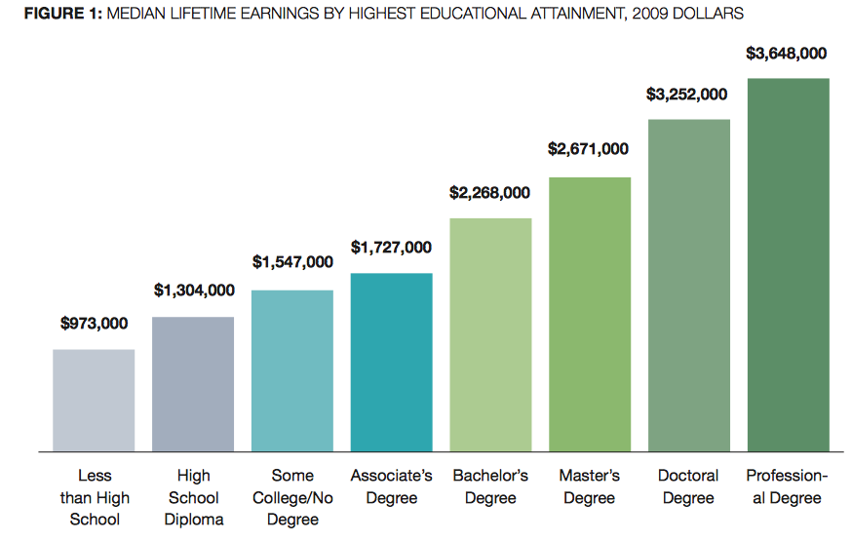
EXISTING SINGLE-SECTOR SOLUTIONS ARE FLAWED
Addressing one aspect of poverty at a time does little to change it.
WORKFORCE DEVELOPMENT
fails to address educational attainment gaps and character.

Slide 7




COMMUNITY ASSETS
Identifying and leveraging community assets to revitalize from within.
Strategy
Process
Build UP’s Approach
A dignified, strengths-based approach
Asset Mapping- a listening tour
Spoke with 40+ members of Ensley+ community
Leverages each community’s uniqueness
Community visioning and trust-building
Assembled advisory subcommittees
Accelerates launch, expansion, and scaling
Build awareness, advocacy, & coalitions
Made positive headlines wherever possible
Requires community collaboration
Partnership-building and collaboration
Hired staff from within the community
Authentically engages dedicated partners
Engaged funding and technical partners
National Foundations
Local Funders and Partners
6

Slide 8
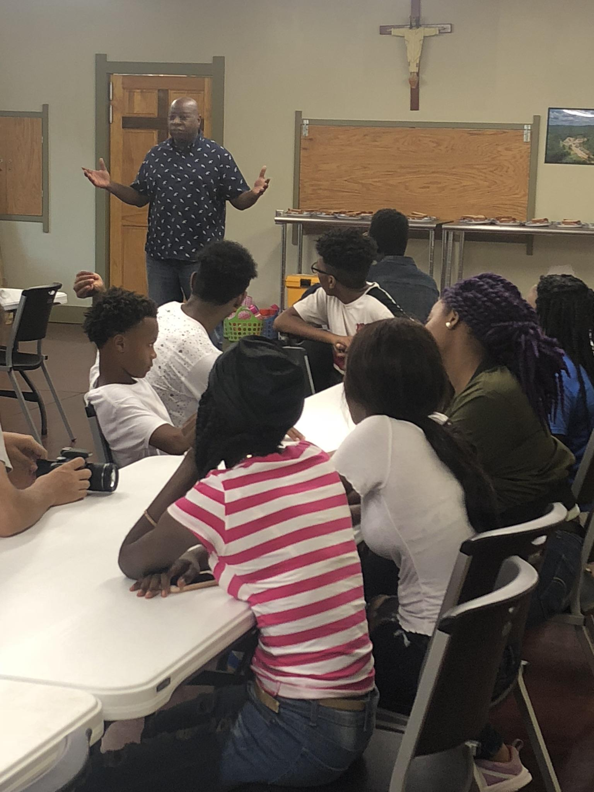




ASSET MAPPING PROCESS
By starting with inclusive inquiry, you naturally build allies and legitimacy in the community.
Who should you be listening to?
Describe the type of people or name specific community roles/titles you would want to hear from.
?
What should you be asking?
What desk research needs to be done prior to engagement? What do you want to learn from folks?
What existing resources can be leveraged?
What facilities, organizations, and human assets in your community can be engaged towards solutions?
What else can you tap into?
Who else shares your passion? What dignified resources could you tap into?

Slide 9


EMPOWERING YOUTH AND COMMUNITIES
Tackling a community’s most pressing issues by empowering and engaging those from within.
Strategy
Process
Build UP’s Approach
Eliminates the need for Superman
Recruit those who are falling through the cracks
Vision: “… to determine their future.”
Develops empathy and understanding
Engage families in the bigger vision
Pilot to Boot Camp to Enrollment
Replaces brain drain with energetic leadership
Build aspirations and expose the possible
Hired staff from within the community
Reframes challenges as learning opportunities
Partnership-building and collaboration
Ensley/ Western area focus for launch
Establishes critical mass for long-term change
8

Slide 10

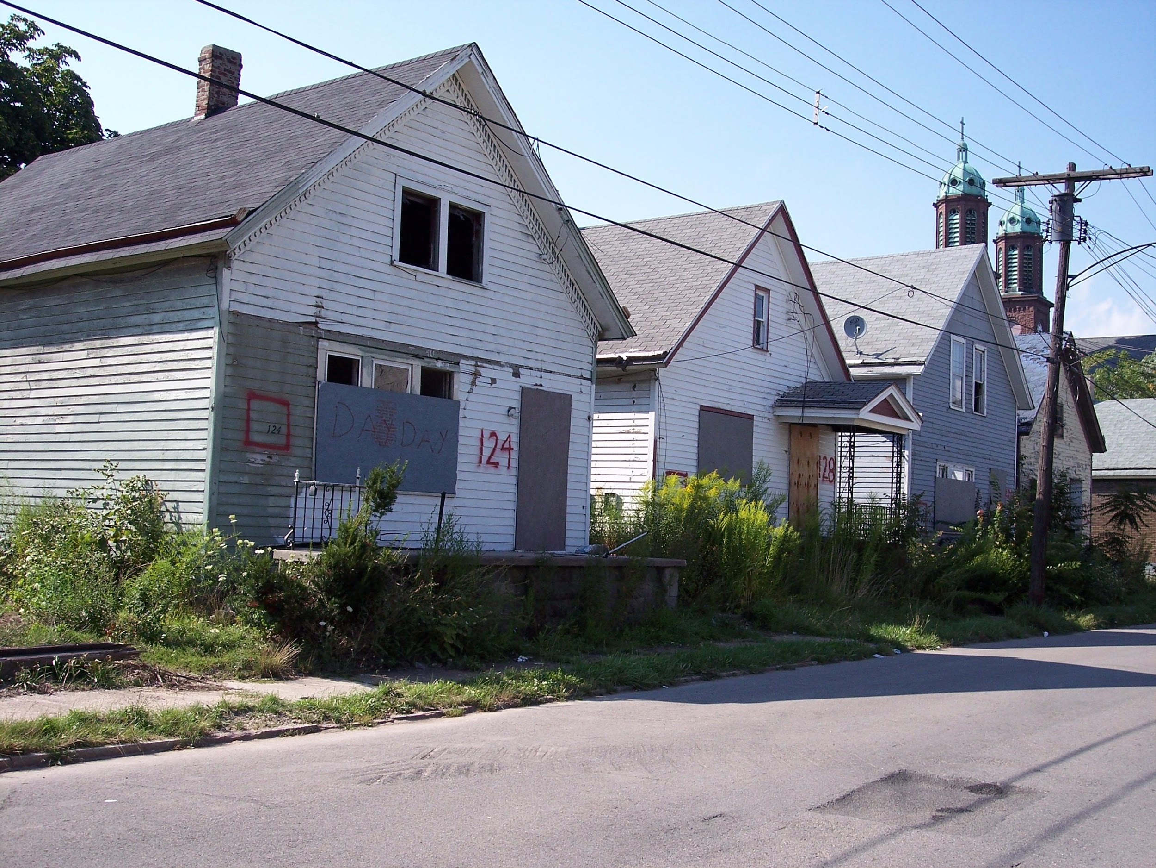


WHAT ARE YOUR COMMUNITY’S MOST PRESSING ISSUES?
How can youth TAKE THE LEAD on solving them?
What’s holding your community back?
Create a short-list of issues your community faces.
Which issues impact kids and families?
Which issues either directly impact youth in the community?
What issues have the biggest upside?
Narrow the list by what issues could have a catalytic effect if resolved or improved.
What learning needs to take place?
What is not known about this issue or how to resolve it? What’s the best plan of attack?

Slide 11



HOMEOWNERS’ NET WORTH 36X RENTERS’
Increased homeownership in America’s urban centers among black and Latinx families
would drastically close the racial wealth disparities and elevate a range of social benefits.
Homeownership Boosts Social Outcomes
Leads to better school performance among children and higher levels of civic engagement and social capital among adults¹
Homeownership Enhances Wealth Creation
Enables wealth creation, which, in turn, leads to enhanced life satisfaction²
Homeownership Improves Health Outcomes
Provides access to better quality health care³
Bramley and Karley, 2007; Haurin, Parcel, and Haurin,2002
2. Grinstein-Weiss et al., 2010
3. Harkness and Newman, 2002
Sources: 1. Schwartz (2010); 2. Chetty, Hendren, and Katz (2015); 3. Kling, Liebman, and Katz (2006)

Slide 12

WORLD-CLASS EDUCATION
Providing a quality, career-focused and individualized early childhood through 12th grade AND postsecondary education AND associated credential and/or certifications.
Strategy
Process
Build UP’s Approach
Expect great outcomes from ALL students
Break all learning down to standards
Hired experienced certified teachers
Personalized curriculum differentiates
Delegate standards among adults and classes
Deployed a blended web-based curriculum
Exposes students to careers and experts
Incorporate technology as needed
Students learn from industry experts
Couples the knowledge with the skills
Engage a postsecondary partner
Students receive industry credentials
Provide the papers & relationships that open doors
Engage multiple workforce partners
Students graduate with a diploma & an associates degree
11

Slide 13



EQUITY = FAIRNESS AND OWNERSHIP
Leveling the playing field by not only providing for fairness, but also ensuring some literal form of ownership of an asset (physical or intellectual).
Strategy
Process
Build UP’s Approach
Education alone does NOT level the field
Identify where the gap is
Students are paid & earn take-home pay
We often take pride in what we build/own
Examine what is possible - dream BIG
Students signed up for bank accounts
Ownership addresses systemic disparities
Align with others who dream big
Students “practice” ownership beforehand
Must be coupled with knowledge to sustain
Find a way to pay for it
Students earn a home & rental property
Positively aligns incentives.
Nudge, don’t budge, on this piece
Home equity depends on youth leadership
12

Slide 14



ENGAGE CROSS-SECTOR PARTNERS
Engaging public, private, and non-profit partners and individuals in ways that are mutually beneficial and catalytic.
Strategy
Process
Build UP’s Approach
Reduces the need for “hand-outs”
Step back and assess where you are
Spoke with 40+ members of Ensley+ community
Requires partners to go beyond
Consider what you can offer others
Assembled advisory subcommittees
Supports the partners bottom line
Formalize relationships if possible
Made positive headlines wherever possible
Provides an array of thought partners
Practice partnering in authentic ways
Hired staff from within the community
Authentically engages dedicated partners
Always follow through & expect the same
Engaged funding and technical partners
13

Slide 15
CROSS-SECTOR PARTNERSHIP NEEDS AND SUPPORT REQUESTS
Build UP seeks partners across numerous public, non-profit, and private sector fields.
Funders: Foundations and Individuals
Start-up and operations funding, facility build-out, tax credit scholarship contributions, in-kind gifts
Commercial Builders and Developers
Site Safety Training, Retired Equipment and Excess Materials, Sponsorships, Expertise/Technical Assistance, Operations
Residential Builders
Training Expertise, Home Renovation Sponsorships, Retired Tools and Excess Materials, Building Curriculum
Civic and Municipal
Landbank Authority Properties, Transportation, Summer Jobs Funding, Housing and Community Development Funds
Legal
Tax-Adjudication Title Work, Tax Credits (Alabama Scholarship Fund, New Markets, Historic, and Low-Income Housing), Liability, Labor, Contracts and Deeds, and Non-profit Corporate Structure
Social Sector
Counseling and Mental Health, Healthcare, Financial Literacy, Parent Trainings (Literacy, Budgeting, Discipline, etc), Mentoring Opportunities, Character-Development and Leadership, Service-Learning Opportunities
Faith-Based Sector
Build Volunteers, Mentors, Character-Development and Leadership Activities, Urban Young Life
Workforce Development
Registered Apprenticeships, Credentialing, Workforce Training Materials, Soft-skills Training, Federal Sub-grant Opportunities
K-12 Education
High School Curriculum Development, Guidance on Blended Learning Models and Personalized Learning Plan Development, Private School Partnership, Linked Governance for Dept. of Revenue Tax Credit Scholarship Accreditation
Higher Education
Dual Enrollment Coursework, Post-secondary Industry Alignment, Transportation
Financial
Community Reinvestment Act Funds, Refinance Loans, CDFI Start-up Assistance, Low-interest Community Development Loans
14

Slide 16
School-Sharing Communities
Any Questions?
Identifying and leveraging ALL communities’ most precious assets.
Providing a world-class, career-focused ECE-12 AND postsecondary education/credential.
Defining equity in terms of fairness AND ownership.
Engaging cross-sector partners in catalytic ways.
Empowering youth to engage with and help solve their community’s most stifling challenges.

