Slide 1


C. Ryan Sprinkle, JD
2007 – 2008 Blackburn Fellow
Stroudwater Associates
Dawson Smith, MSHA
Director, Network Development & Affiliations
UAB Health System
August 23, 2019

Slide 2
Our Time Together
Context. What rural healthcare crisis?
Pine Trees and Blue H’s. What do pine trees have to do with rural hospitals?
Alabama’s Black Belt. A short primer in barriers to access and associated health outcomes.
Ensuring Future Access. Market and policy reactions to the crisis.

Slide 3
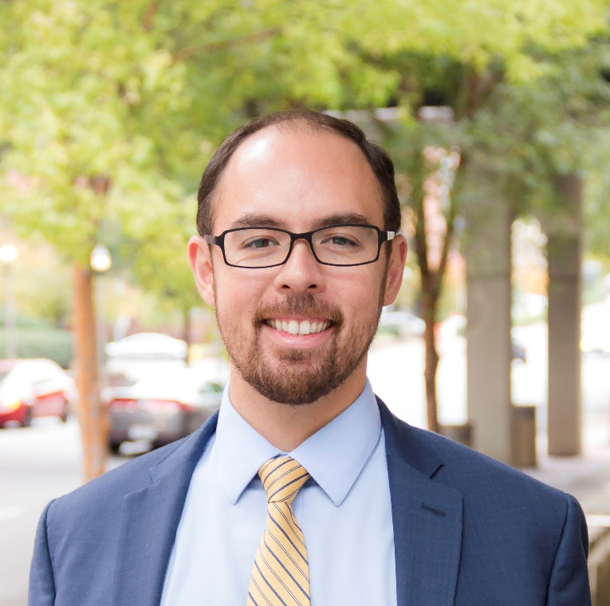
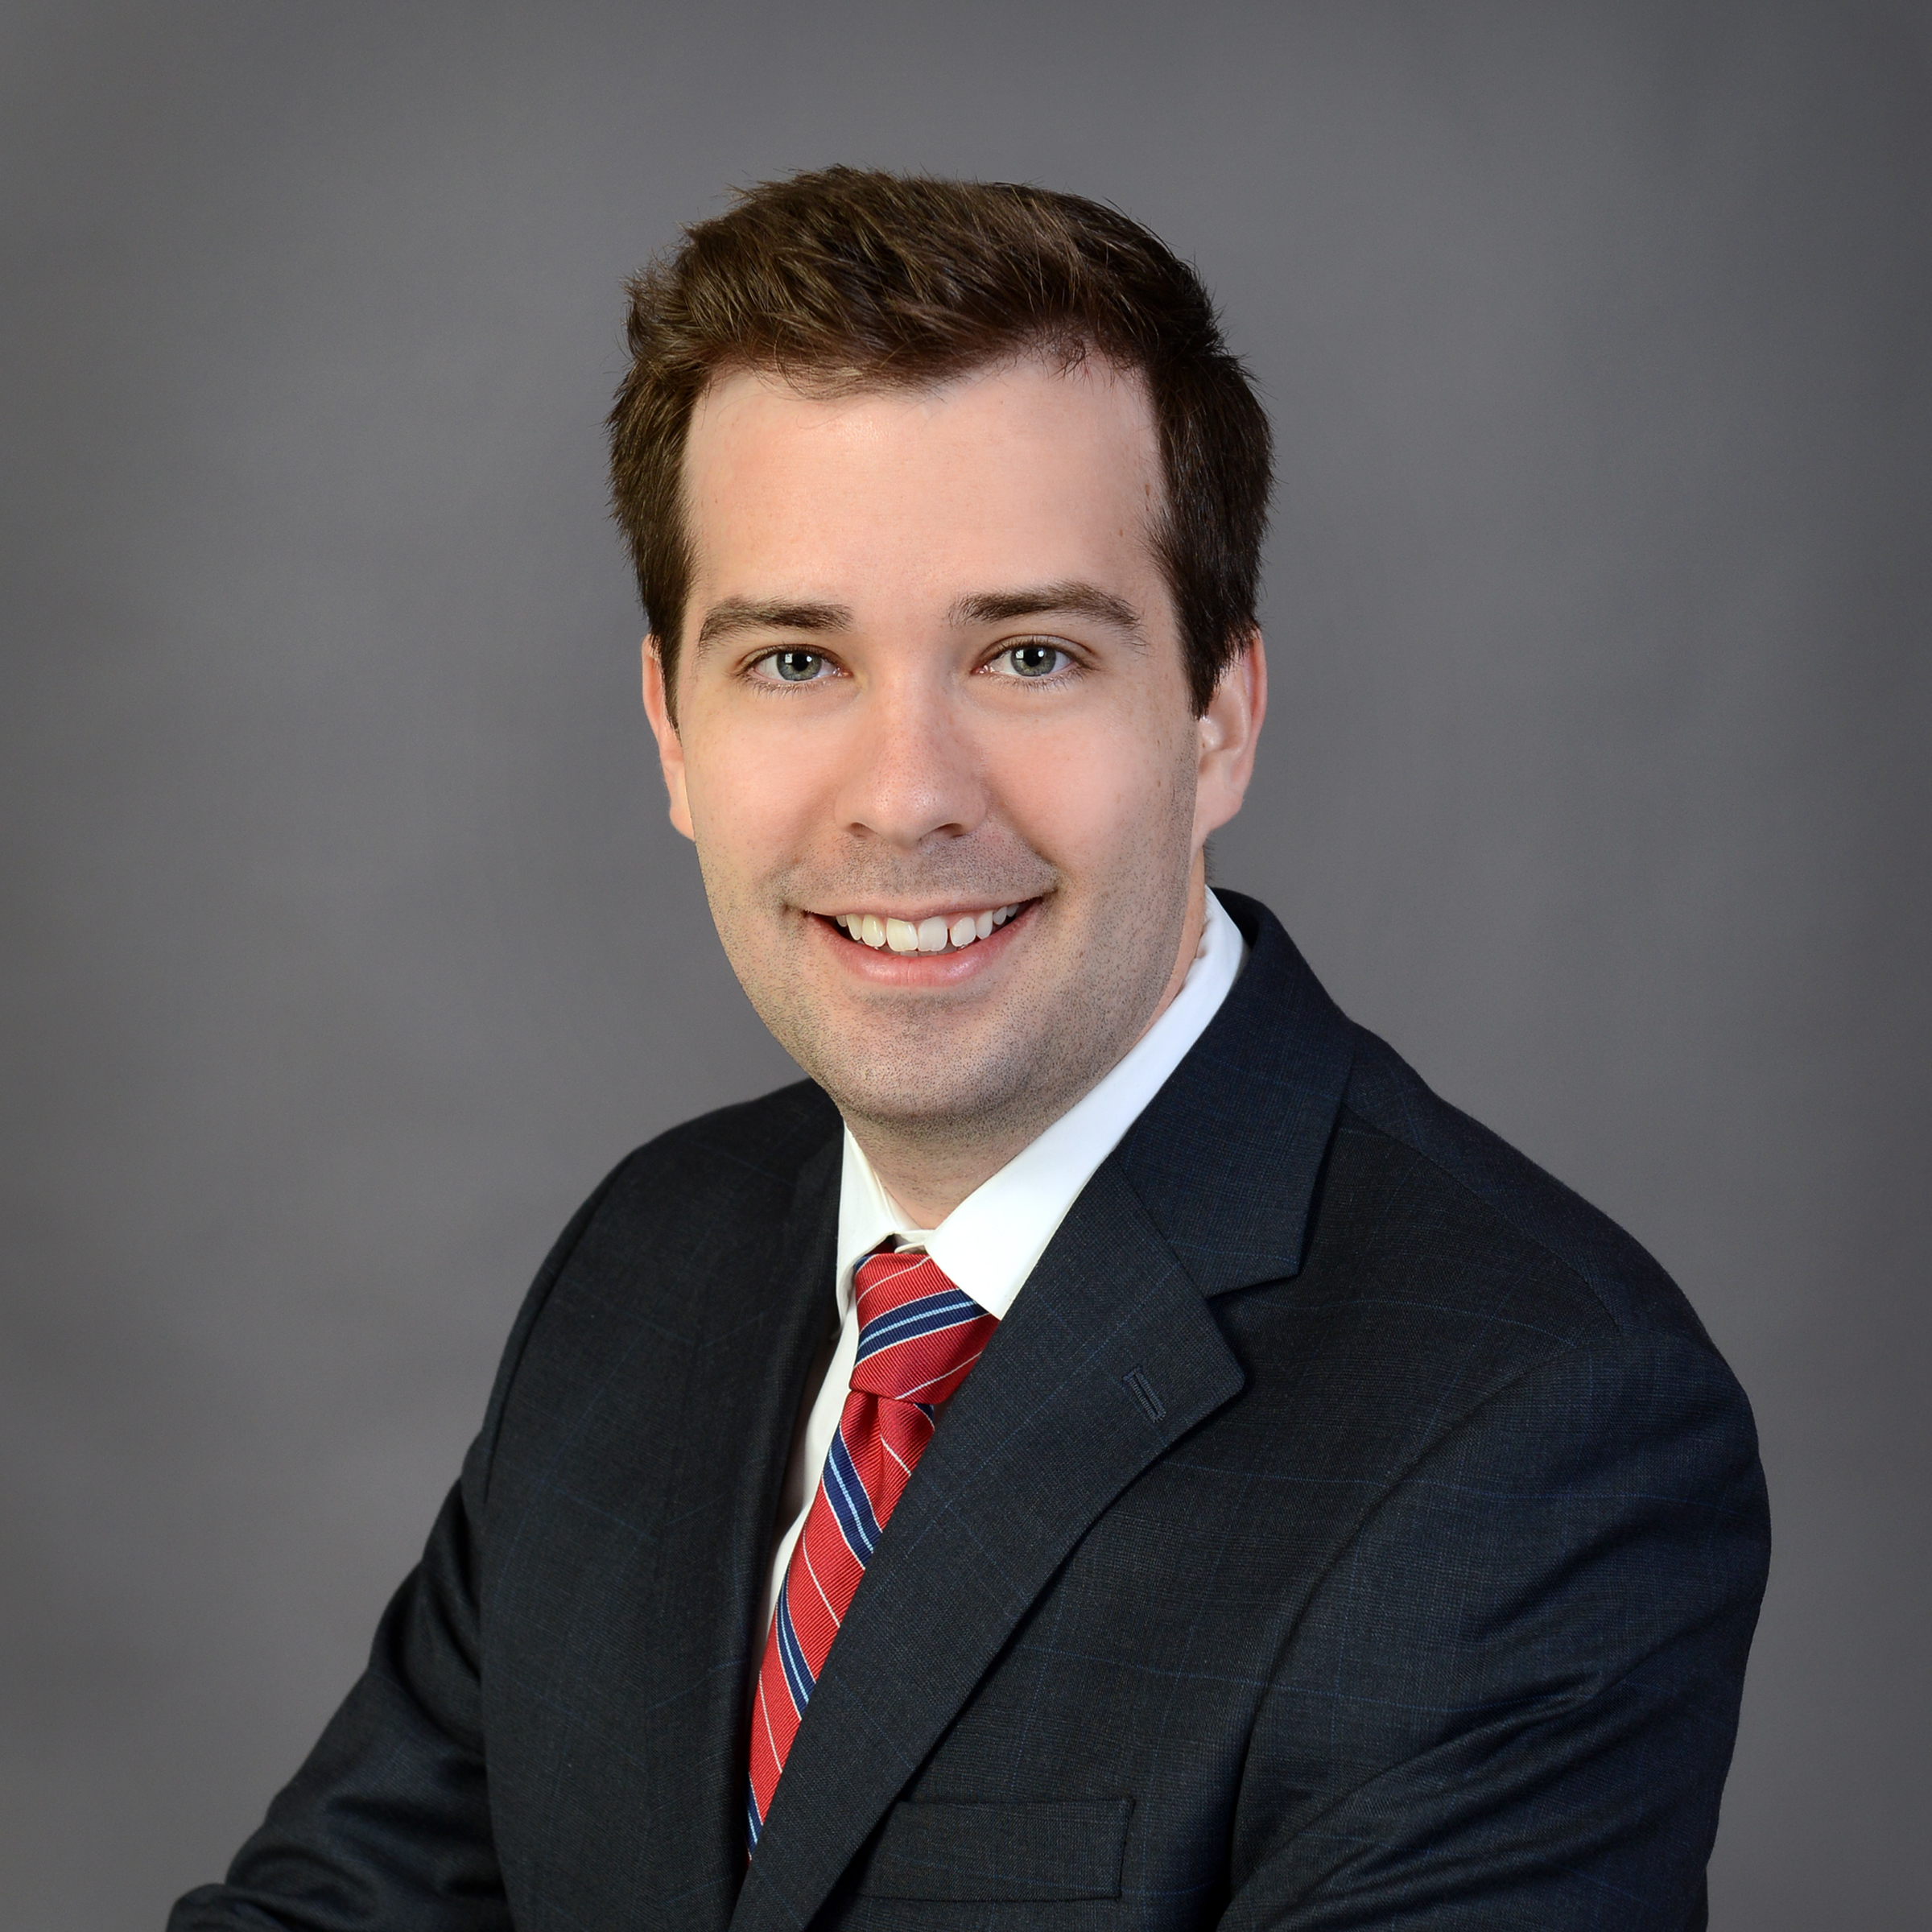
Introductions
DAWSON SMITH, MSHA
Director, Network Development & Affiliations
UAB Health System
C. RYAN SPRINKLE, JD
Practice Leader
Senior Consultant
Recent Client Engagements
Albany Medical Center/ Glens Falls Hospital
Mayo Clinic/HCA Health
Rural hospital in Alabama’s Black Belt
AREAS OF FOCUS
Business Development
Community & Rural Hospital Management
The Resource Center for Rural Hospitals
Alabama Physician Network (CIN/ACO)
EDUCATION
M.S.H.A., The University of Alabama at Birmingham
B.S., Lipscomb University, majoring in economics, finance, and management
AREAS OF FOCUS
Performance improvement/Turnaround services
Affiliation/M&A advisory
Distressed hospitals
Strategic planning
EDUCATION
J.D., The University of Alabama School of Law, focus: healthcare law and healthcare management graduate coursework
B.S., The University of Alabama, majoring in economics and specializing in finance

Slide 4
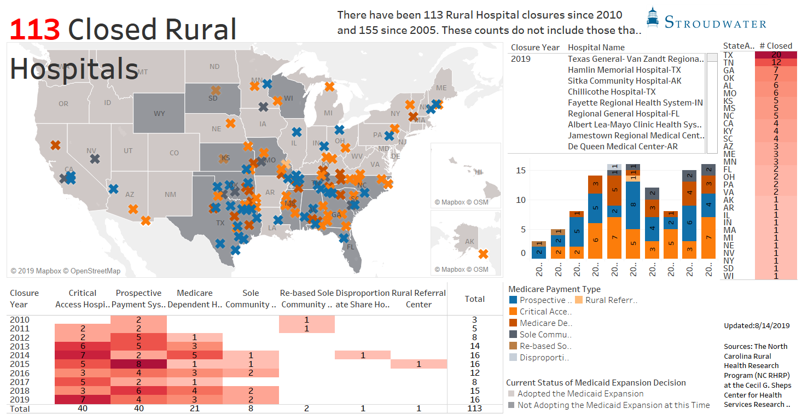
What Rural Healthcare Crisis?
113 rural hospital closures since 2010
Alabama is fifth, 1 closure behind GA and OK (7 each)
Number of “urban” hospital closures is slightly fewer during the same period

Slide 5
Pine Trees & Blue H’s

Slide 6


So What About Pine Trees?
Ryan Dezember
October 9, 2018
Federal Funding. Beginning in the 1980s, generous federal programs designed to encourage reforestation of farmland lowered the costs of entry into the timber business.
Increase in Supply. By 2020, amount of timberland across the Southeast will have quadrupled since 1980.
Changing Market Forces. Most species of southern pines reach maturity in 25 to 30 years – around the time the Great Recession and housing crisis hit.

Slide 7
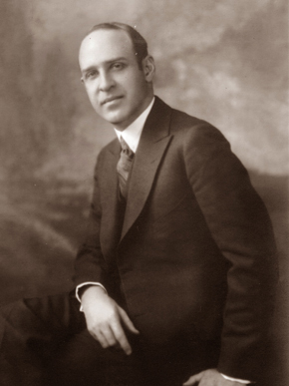
Parallels for Rural Hospitals
Federal Funding. The 1946 Hill-Burton Act provided means of matching state and federal funds to assist in construction or renovation of healthcare facilities.
Increase in Supply. Between 1946 and 1975, Hill-Burton assisted in financing almost one-third of all hospital projects in the nation.
  Program was credited with providing hospital facilities in rural areas.
Changing Market Forces. Declines in inpatient utilization fueled by:
  Advances in medical science
  Pressures around cost containment
  Changes in local market demographics
Senator Lister Hill (Alabama, 1938 – 1969)

Slide 8
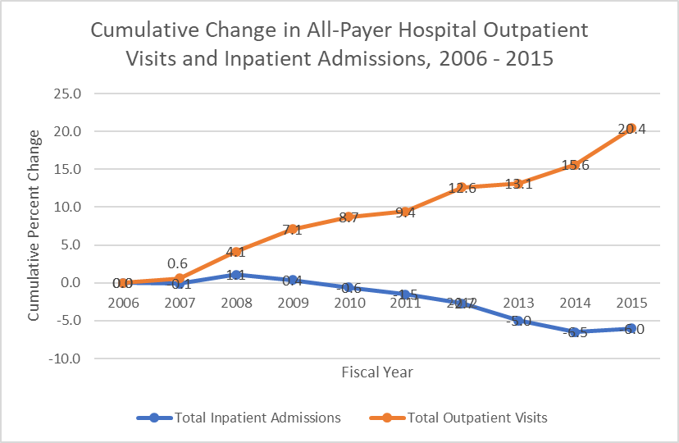
Hospital Outpatient Visits and Inpatient Admissions
“Acute inpatient services,” A Data Book: Health care spending and the Medicare Program, MedPAC (June 2017).
Ironically, the movement from inpatient to outpatient care can be detected as early as 1972, near the end of the Hill-Burton program.
This reduced demand for inpatient services leaves hospitals with large, fixed assets that must be reconfigured to provide outpatient care.

Slide 9
Declining Medicare Margins Reduces Ability to Cover Operating Costs
Medicare margins are expected to decline due to a tightening labor market and other sources of cost inflation projected to outpace growth in payment rates.
Source: MedPAC
Private commercial insurers are also applying pressure to control and limit growth in reimbursement.

Slide 10
Changing Nature of Healthcare Delivery Requires Time and Investments
Imperatives for Health Systems:
Reduce Costs – both unit costs and total costs
Improve Delivery Model – convenience and consumer-focused; “wellcare” instead of “sickcare”
Upgrade Infrastructure – develop facilities that provide foundation for next generation of healthcare delivery (e.g., outpatient, ambulatory, retail, telehealth)
Rebuild Healthcare
Infrastructure
Value Potential
Transform Care Delivery Model
Reduce Cost of Operations
Most rural hospitals struggle to attract and retain management team members and staff
Given years of eroding financial performance, many rural hospitals lack balance sheet strength or free cash flow to fund infrastructure investments
Time
Source: Atrium Healthcare (2018)

Slide 11
Adding Insult to Injury: Rural Population Decline – National Census Data
Based on 2010 Census, less than 20% of Americans lived in a “Rural” area
“Urban Clusters” also declined to less than 10% of Americans
Fewer people in rural areas means decreased demand for healthcare services.

Slide 12
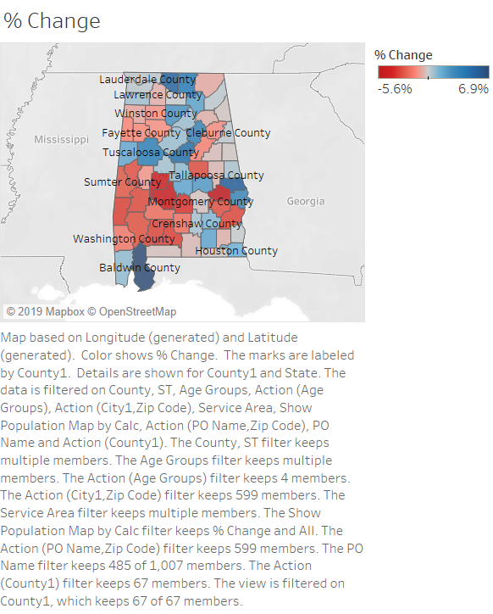
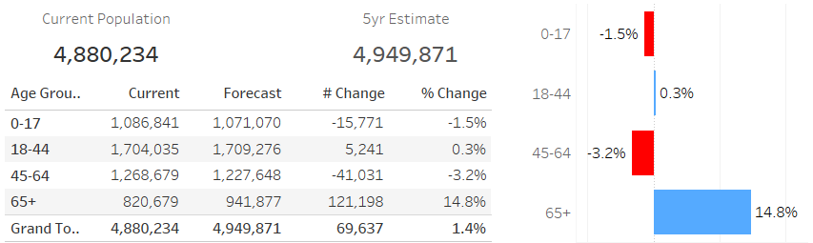
Adding Insult to Injury: Rural Population Decline – Alabama Projections
Alabama’s population projected to increase marginally by 1.9%. Growth almost exclusively in urban/metro counties.

Slide 13
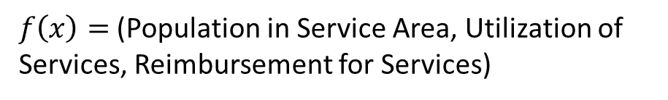
Financial Viability of Rural Hospitals
$f\left(x\right)=$ (Population in Service Area, Utilization of Services, Reimbursement for Services)
Population in Service Area
Utilization of Services
Reimbursement for Services

Slide 14
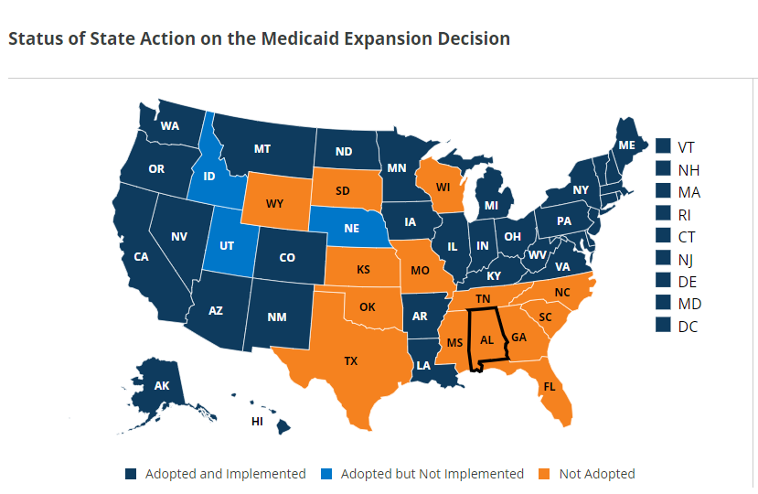
Medicaid Expansion/Non-expansion States
The ACA assumed that all states would expand Medicaid.
Because this “expansion” population was assumed to be covered via Medicaid, the ACA reduced disproportionate share (DSH) payments to hospitals that were providing care to this non-covered segment of the population.
The Supreme Court ruled in NFIB v. Sebelius that Medicaid Expansion was optional.
Hospitals in non-Expansion states lost both their DSH payments for this population and never saw this population segment covered via Medicaid.
Source: Kaiser Family Foundation, “Status of State Medicaid Expansion Decisions: Interactive Map,” (May 13, 2019)

Slide 15
Alabama’s Black Belt
Challenging Operating Conditions Compounded by Local Health Characteristics

Slide 16
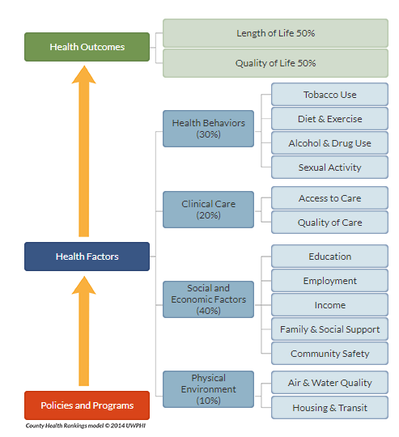
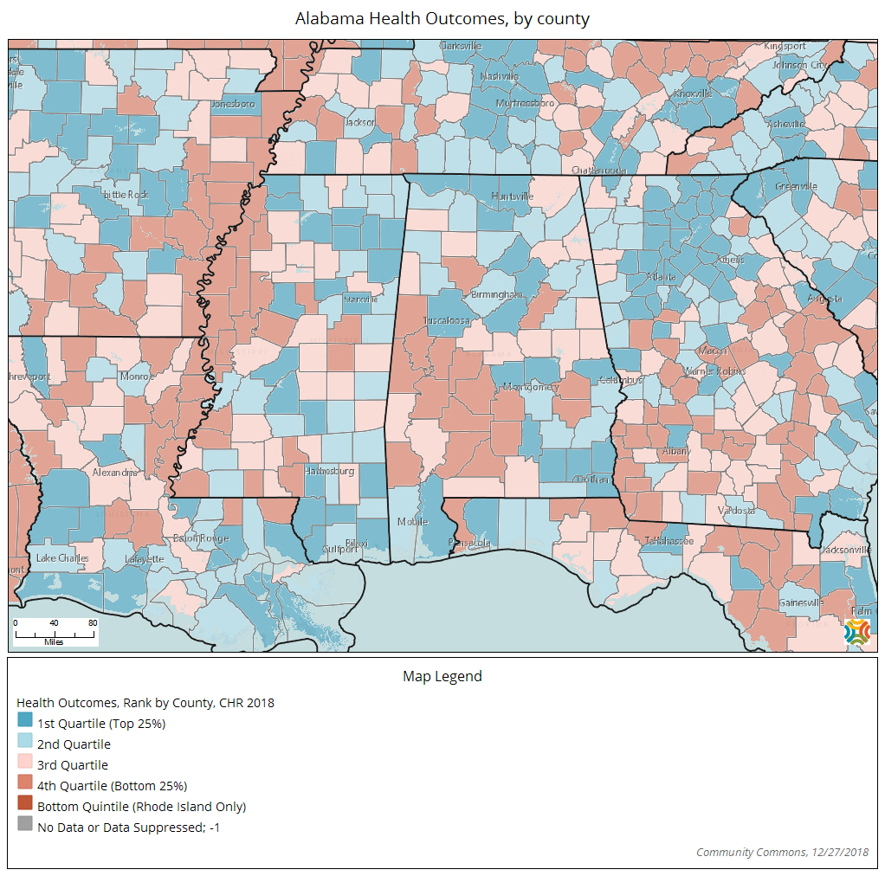
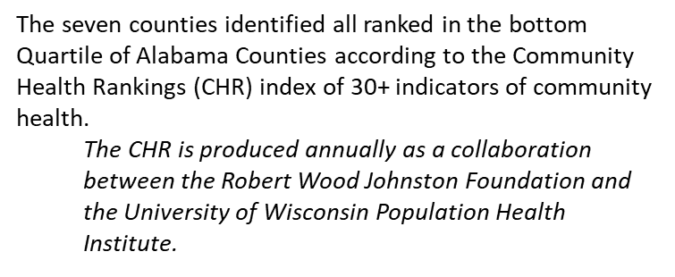
Good Healthcare Is More Than Just Access to a Hospital
Health Outcomes, Ranked by County, CHR 2018
Greene
Hale
Perry
Sumter
Marengo
Dallas
Wilcox
Source: 2018 CHR, CommunityCommons.org

Slide 17
But Access to Healthcare Providers Is Vital to Addressing Health Outcomes
The lower rate of PCPs in these counties compared to the Alabama and national averages indicates a clinical care barrier to access in the region.
These counties are classified as “Health Professional Shortage Areas” (HPSAs) in primary care, dental care, and mental health.
Diminished access to proper mental health providers often means that patients suffering from mental health issues are placed in incorrect care settings, not seen by correct mental health providers, and often must travel great distances to access appropriate mental health care.
While these Black Belt counties have an Infant Mortality Rate below that of Alabama, the State’s and these counties’ incidence rates are above the national average.

Slide 18
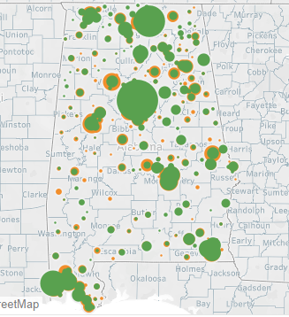
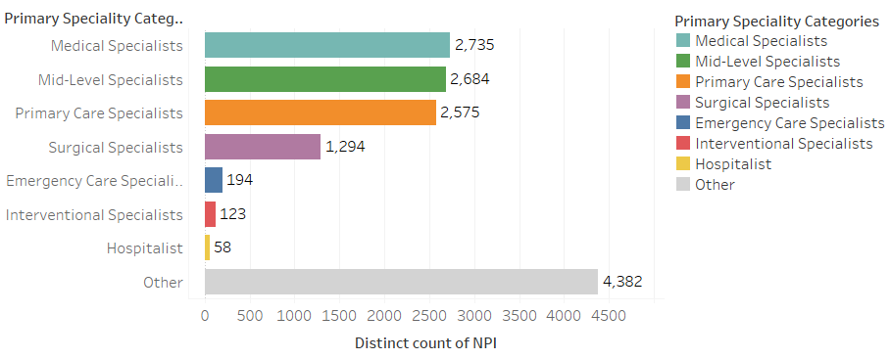
Primary Care & Midlevel Specialists Across Alabama
Greatest “density” of primary care physicians and mid-level providers (NPs/PAs) predominately in urban/metro areas across the state.
In rural communities, provider access often in single digits (and very often aging).
Commonly cited reasons that rural communities struggle with provider recruitment:
  Medical school debt-levels and income potential in rural communities
  Personal and family decisions concerning rural vs. urban lifestyles
  Financial weakness of rural hospitals

Slide 19
Ensuring future access

Slide 20
Momentum
Local
State
National
Conversations happening at every level in every sector.
Notes:
Federal Office of Rural Health Policy
State Offices of Rural Health
Alabama Rural Health Association
Rural Health Task Forces in Associations
AlaHA Rural Constituency
National Rural Health Resource Center
Rural and Underserved Communities Health Task Force
What is being done to ensure continued access to quality affordable healthcare in Rural American and Rural Alabama?
There is no shortage of parties interested in fixing rural healthcare; more and more parties join the efforts each year.
Stakeholders
National conversations and political platforms
Triple Aim
88% operating in the red – keep throwing cash at facilities?

Slide 21
Balancing Approaches
Stabilization versus Transformation | Incrementalism versus Disruption
Federal versus State | Strategy versus Policy

Slide 22
Resource Center
Alabama Legislature bill passed in 2018
Staffed and managed by UAB Health System
Eligible Hospitals: Rural, Non-profit or Public
Technical Assistance
Rural Administrative Residency Program
Finance
Quality
Access
Health Status
Compliance
Coding
Purchasing
Quality
Planning
Recruitment
Cost Reporting
Insurance
Notes:
Hire staff according to demographics of the state.
Submit an annual report to the Legislature, State Finance Director, and Medicaid Commissioner
Report shall include:
Financial improvement of participating hospitals
Satisfaction survey from management and the board of participating hospitals
Improvements in quality
Improvements in access to care
Improvements in health status
Establish a rural administrative residency program in conjunction with UAB MSHA
Originally intended to support Global Budget Pilot

Slide 23
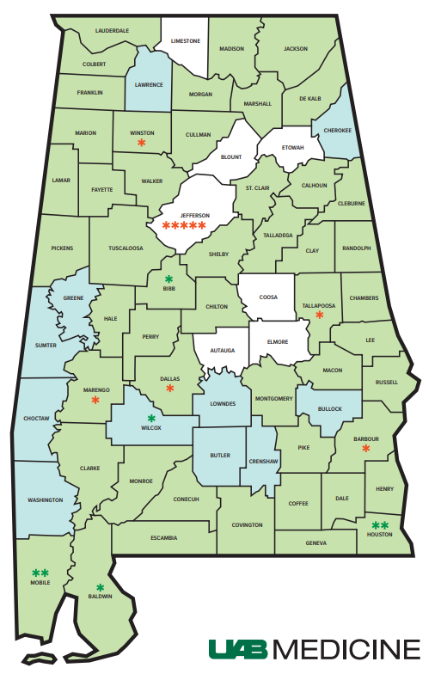
Telemedicine
Survey by Definitive Healthcare
  Inpatient Utilization up nationally 84% from 54%
  90% of the healthcare providers surveyed indicated that their future telehealth investment plans are slated to occur within the next 12-18 months.
Improved reimbursement and regulatory environment
Barriers: broadband access and quality
Services Available Across AL:
  Critical Care (stroke, ED, eICU)
  Specialist Services (nephrology)
  Ambulatory Care (cardiology, MFM)
  Remote monitoring
Other states:
UMMC’s Center for Telehealth is connected to more than 200 locations
UPMC provides access to more than 35 specialties via Telehealth
Notes:
Adoption flat in outpatient settings
Initial success in tele-critical care “round & respond”
Reduction in mortality and O/E by approx. 50%

Slide 24
Revenue Diversification
Standard Sources of Revenue
  Inpatient Services
  Emergency Services
  Rural Health Clinics
  Federally Qualified Health Centers
  Swing Beds
  340B & Contract Pharmacies
  Lab Partnerships
Alternatives
  Comprehensive Retirement Communities
  Private Recovery Suites in Ambulatory Surgical Centers
  Fitness Centers
  Non-healthcare lines of businesses
  Investments

Slide 25










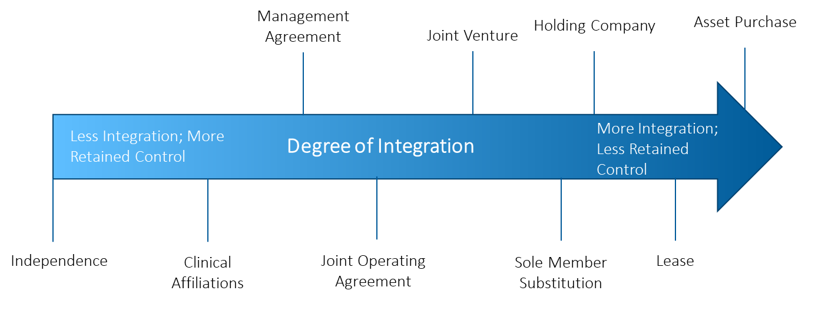
Continuum of Collaboration
Types of Relationships
  No risk to Risk
  Transfer Agreements, PSA, Affiliate, JV, M&A
  Range of Corporate Services
45+ rural hospitals, 50% with some affiliation

Slide 26
Talent Pipeline
$192,000
Estimated Shortages in Rural Areas
  Primary Care – 14,900
  Dental Health – 10,635
  Mental Health – 6,894
Free Tuition
  NYU School of Medicine (incoming class this fall)
Medical School Scholarships
  Board of Medical Scholarship Awards
  Rural Practice Scholarship Program
Rural Tracks
  KU Rural Training Track
  Rural Scholars Program
National Health Service Corp Scholarship or Loan Repayment Program
  Up to $50,000 for 2 years depending on HPSA score
Community Partners like BCBS
  $7.8m for Alabama
  120-150 students over 5 years
  Ex: $3.6m for 12 scholarships per year for 5 years for UAB
Physician Rural Tax Credits $5000-20000
J-1 Visa Programs
Area Health Education Centers
Notes:
Find that study from Christy Lemak’s email on % not willing to fulfill obligations to rural areas.

Slide 27
Public Financing
Federal & State Level
  Medicaid Expansion
  Wage Index
    Complex Formula
    25th Percentile
City & County Level
  Sales Taxes
  Ad Valorum
New York, California, Massachusetts
Alabama
GAP CONTINUES TO WIDEN

Slide 28
Provider Designations
Critical Access Hospital
(CAH)
25 beds or less
Medicare Dependent Hospital
(MDH)
100 beds or less
25-mile requirement
Community Outpatient Hospital
(COH)
REMC, REACH, SRHA
Sole Community Hospital
(SCH)
35-mile requirement
Avg LOS of 96 hours
Cost-based
Medicaid reimbursement?
60% of IP days attributable to M’care
75% of IP days attributable to M’care
<50 beds
No inpatient services
24/7 Emergency & Observation Care
Transportation to Hospital with Inpatient services
Outpatient Care
Notes:
Rightsizing

Slide 29
Global Budgets
Volume over Value | Triple Aim
Pennsylvania Rural Health Model
Performance Period: 2019-2024
Components:
  Global Budget
  Hospital Care Delivery Transformation
Targets
  Start with 6 rural hospitals and increase to 30 by 2021
  Global Budget 75% of NR in Year 1, 90% thereafter
  Keep spending growth below 3.38%
  Achieve $35m in savings for Medicare
Notes:
Cannot be all things…rightsizing

Slide 30
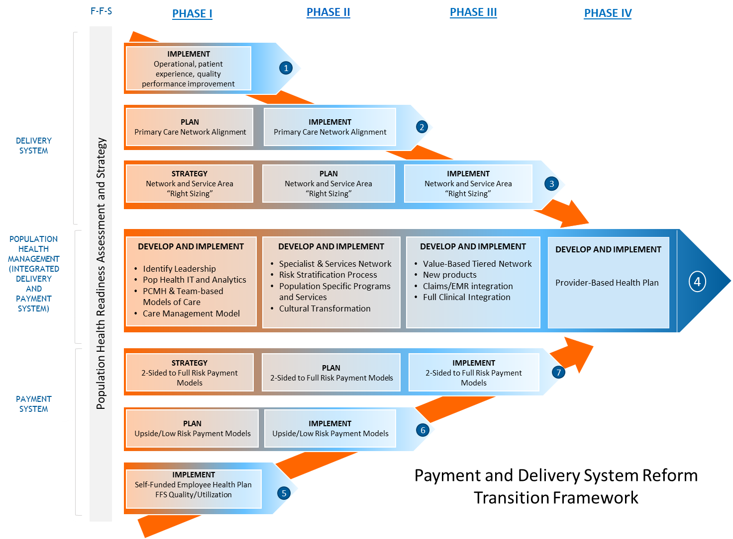
Population Health
Public Health or Value-based Care?
Social Determinants
Care Management
Payment Models
  Shared Savings (MSSP ACO)
  Next Gen ACO
  Primary Care First
  Comprehensive Primary Care +
  Bundled Payments
  Comprehensive Joint Replacement
  Oncology Care Model
  ESRD

Slide 31
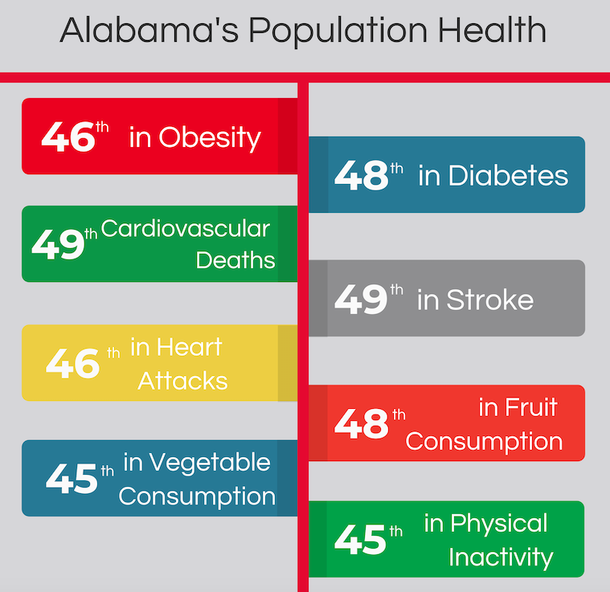
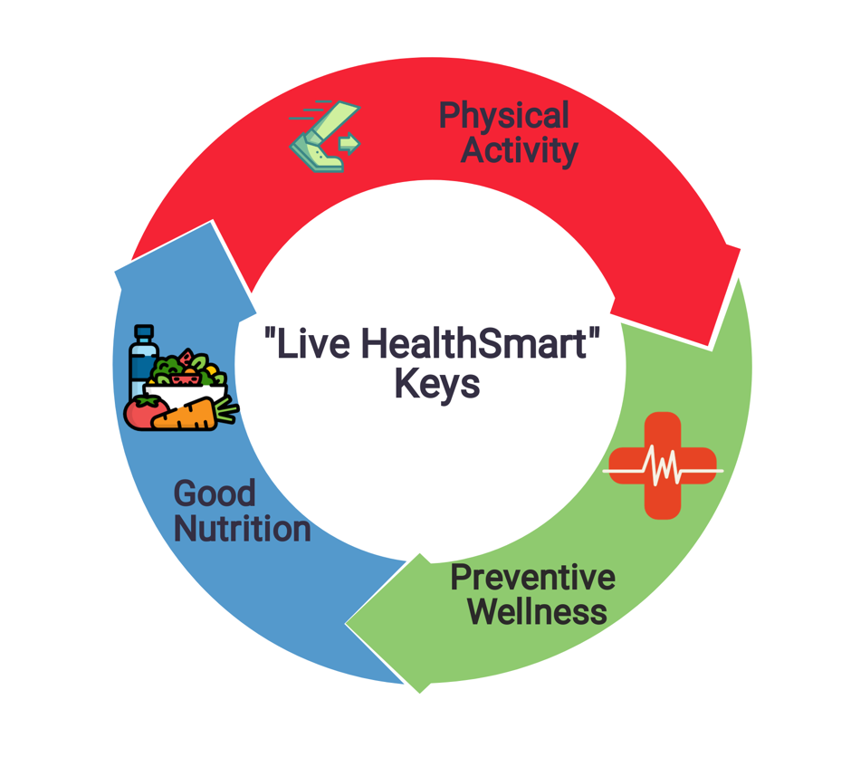
Healthy Alabama 2030
The Goal: Move Alabama out of the bottom 10 in national health rankings by 2030
Healthy Alabama 2030 will be launched with a series of demonstration projects in neighborhoods, workplaces, and schools, targeting policy, system, and environmental changes
Sites in these initial areas will be encouraged and trained to earn the designation of “Live HealthSmart Alabama” Zones
Initial demonstration project areas will include: UAB, Woodlawn/Kingston, Ensley/Bush Hills, and East Lake

Slide 32

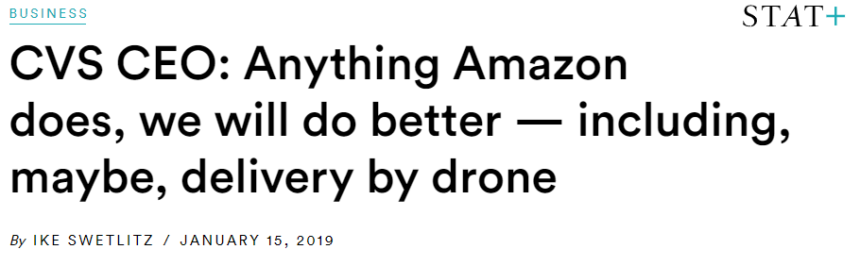

Other Innovations in Care Delivery
Internet of Things
  Vitals
  Scales
  Wearables
  Gamification of Health or Quantified Self
Drones
  Medication Deliveries
  Emergency Response
Notes:
Hep-C patients
FitBit’s trophies and badges

Slide 33




Other Innovations in Care Delivery (cont’d)
Increasing Presence of Retail Medicine
  CVS Minute Clinic, Walmart Care Clinic, privately-owned/operated retail clinics, etc.
  Penetration in rural markets continues to be minimal but growing
Clinic Staffing | Clinic Services | Clinic Payer/Pricing
NPs | Open 7 days/nights; walk-ins; no peds.; on-site Rx; labs, exams, procedures | Most payers accepted; menu pricing
NPs | Open 7 days; walk-ins; | Most payers accepted; menu pricing; online payment
NPs | Open 7 days; walk-ins; limited labs, screenings, exams, procedures | Insurance accepted at most locations; menu pricing

Slide 34

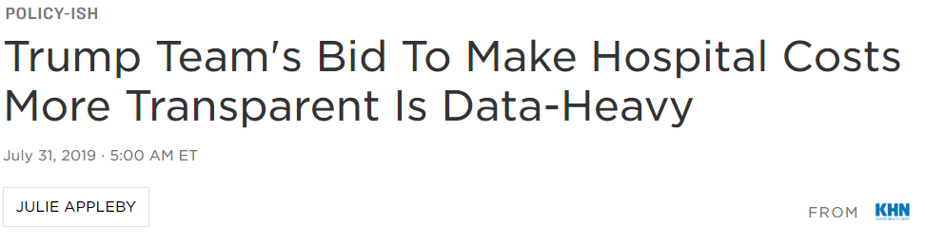

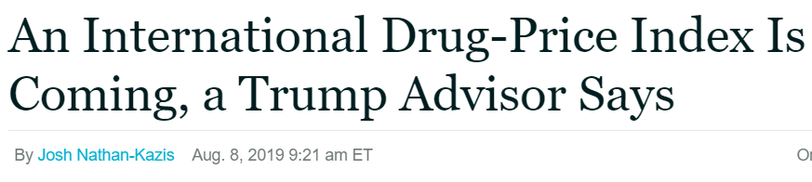
Other Policy Initiatives
Price Transparency
Drug Pricing
  International Drug Pricing Index
  340B
“Regulatory Sprint to Coordinated Care”
  Substance Abuse PHI
  Stark
  AKS
  HIPAA
Recent Developments

Slide 35
Big Ideas?
Discussion and Q&A

Slide 36
Dawson Smith, MSHA
C. Ryan Sprinkle, JD
(205) 975.7558
(205) 270.9740
wsmith@uabmc.com
crsprinkle@gmail.com

