Slide 1
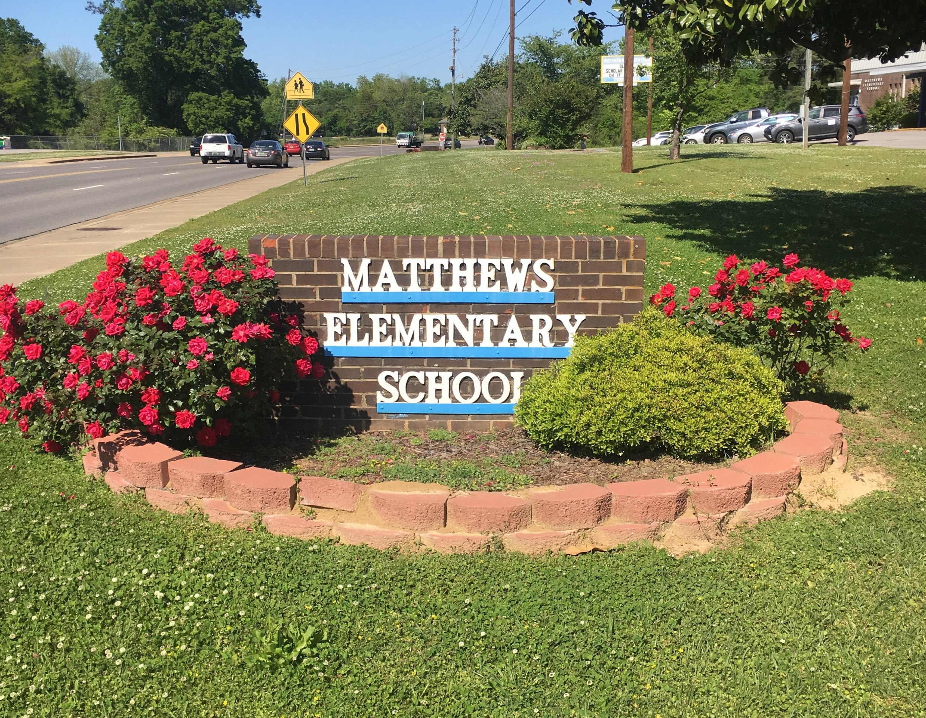
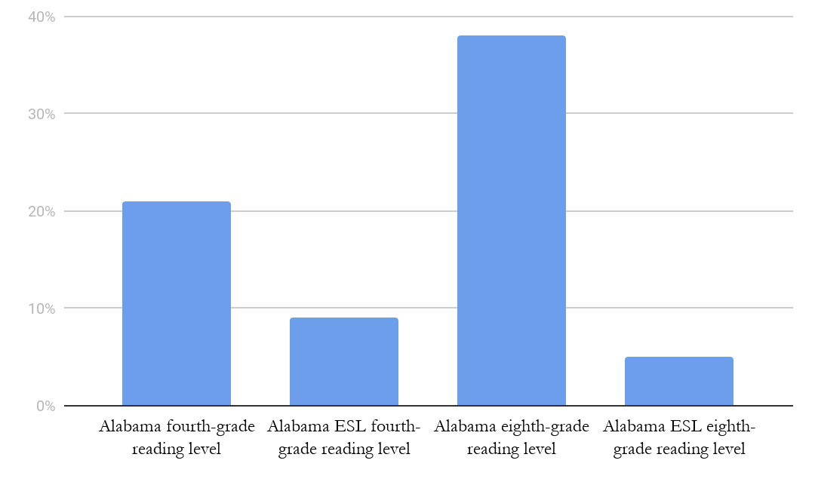
DCS Group 5 - Building ESL Resources for Mainstream Educators
Logan Goulart, Bhavana Ravala, Juliana Strobing, and Trey Sullivan
University of Alabama TESOL
Project Activities
Evidence of Need
Intended Outcomes
Sustainability
The best way to tackle the issue of insufficient ESL resources is to to provide current ESL teachers with the most effective resources possible. This can be efficiently done through an accessible online environment. To meet this need, the students will create an online professional development course for these ESL teachers. Mainstream teachers will also be targets for this course as well. Since many of the ESL students are “mainstreamed” it is vital that these teachers be equipped with the skills necessary to navigate how to deal with ESL students. It will be self-paced and free to register for all who want to take it. At the end of the course, they will receive a certification in professional development and leadership. The course will be broken down into three overarching units: what it means to be a leader, how to be a leader in ESL, and resources for the future. We created these three units because they cover not only ESL specific material, but deals with concepts on how to create a conducive learning environment for all students.
The content of the course itself is what the community partner will be for, as the class is not qualified nor has the experience to create. We would work in tandem with the community partner to make sure that the vision for our course is maintained throughout the creation process. These three units are essential to the success of this course and for advocating for a better future for ESl students. We will be in close contact with the community partner during the course creation phase to ensure that the mission and vision of the course is maintained correctly. The course will last for the month of April, and then the survey will be sent out on May 1st.
Alabama students average below the national percentage in reading scores on NAEP exams. 21 percent of Alabama fourth-grade students scored at proficient levels in reading on the same 2017 assessment. Alabama fourth-grade ELL students scored at 9 percent proficiency, which follows the national results.¹ When comparing all subgroups, “students who are African-American, English Learners, and in special education all perform at a lower level than do economically disadvantaged students as a group...among all the subgroups English Learners appear to be struggling the most. They are ranked low in all subjects, especially science and reading – where they fall below all racial groups, economically disadvantaged students, and students in special education.”² At the same time, the intersectionality of literacy is important to note; non-white students in poverty experience extremely low levels of reading proficiency. For students who fit this demographic and are also English Language Learners, illiteracy in the eighth grade is the norm.³ Nationally, the average ELL enrollment of a public school is approximately 8 percent of the total enrollment, and of this 8 percent, 76.6 of students speak Spanish or Castilian as their home language while 77.2 percent are ethnically Hispanic (statistically includes Brazil)⁴. Students face a variety of barriers, but those who face multiple barriers to literacy rarely perform as well as their peers and the achievement gap will affect them throughout their life.
Teachers in the Tuscaloosa County School System feel supported in their efforts to include ESL-friendly reading and language arts curriculum, but expressed the need for more resources and better training in ESL programs. Currently, any professional development unique to Tuscaloosa’s system needs has to be planned by the ESL program specialists, who are stretched thin, unable to care for both the students, ESL teachers, and mainstream teachers adequately.
Short term outcomes of the project include the immediate skills and instructional tools that participating educators will develop through their participation in the course. Through participation in professional development units, educators will have a better understanding of how to reach ELLs in their mainstream classrooms. Educators will also gain Professional Development Units that can be applied to their recertification and school requirements.
The program will benefits ELLs in the Tuscaloosa community primarily but also in Alabama, as the program will be specifically tailored to needs in Tuscaloosa County, but open to educators across the state. ELL student needs in the classroom will be better met once teachers have specific training on inclusion and adaptation for lessons in the classroom.
Additionally, student families will benefit from educators that have a better knowledge of how to communicate with parents of young students, parents who may not speak English and who may be illiterate in their native language.
The long-term outcome of the program is to provide educators the skills they need to address the needs of unreached students, ultimately increasing literacy rates of elementary ESL students in Tuscaloosa County so they may be better prepared to succeed in high school and graduate, better prepared to enter the workforce, and able to communicate effectively to be contributive members of society.
The TESOL program will develop a repeatable curriculum that can be adapted to suit different needs expressed by the Tuscaloosa educational community. With Blackburn’s resources, the course will be established and added to the professional development programs currently offered to public educators by the University of Alabama. Professors may continue to offer the program after this cycle for educational PD and conferences in the state of Alabama.
Blackburn students will have a better understanding of the needs of the Tuscaloosa educational community and through participating in training, recruitment, testing, and assessment of the course. Potentially, future classes or groups of students will be able to use our work in establishing the course to repeat it or adapt it to a similar issue in another Alabama community.
Our largest area of sustainability is through the course participants. Educators who participate in the course can use their new skills and knowledge and share that knowledge with team teachers, at staff meetings, and with their school’s leadership to spread a culture of better inclusivity within their school. If the course is beneficial, others will notice and may wish to repeat the course specifically for their school or may wish to adapt a few of the strategies in a school-wide effort to promote ESL literacy and achievement.
Teacher
Team
School
District
Alabama Reading Levels (2017)
January 10 - February 15 | Course is created with the help of community partner
February 20 | Course is tested and certified by Alabama State Department of Education
February 21 - March 31 | Recruitment emails and flyers distributed to schools and area educators
March 1 - March 31, 2020 | Enrollment Open for the Course
April 1 - April 30, 2020 | Instructional Period
May 1 | Reaction survey administered
Bibliography
Dailey, Don. “Statewide Proficiency for Multiple Student Subgroups: Reading.” 2019.
Dailey, Don. “How Are Alabama Students Performing? 2018 Scantron Results.” 2019.
Dailey, Don. “Test Scores and Poverty: Who Exceeds Expectations?.” 2019.
U.S. Department of Education, National Center for Education Statistics, EDFacts file 141, Data Group 678, extracted October 18, 2018; and Common Core of Data (CCD), “State Nonfiscal Survey of Public Elementary and Secondary Education,” 2016–17. See Digest of Education Statistics 2018, table 204.27. https://nces.ed.gov/programs/coe/indicator_cgf.asp
*“reading level” defineed on grade-level proficiency in accordance with U.S. Department of Education reading standards.

