Slide 1
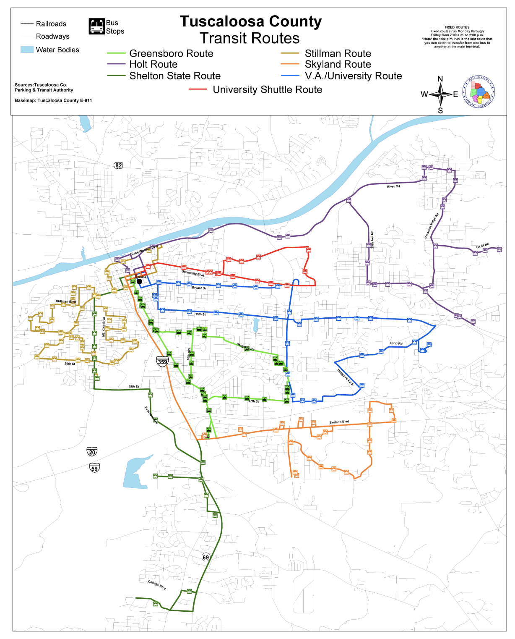
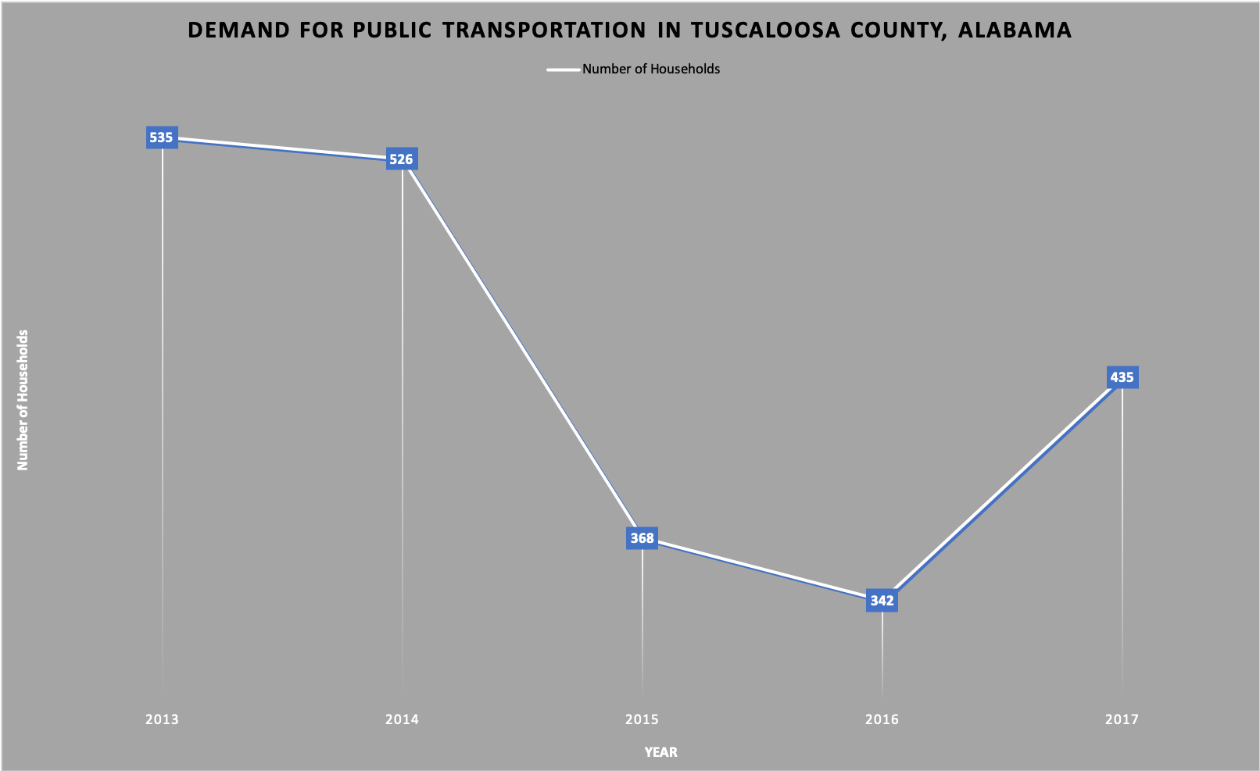
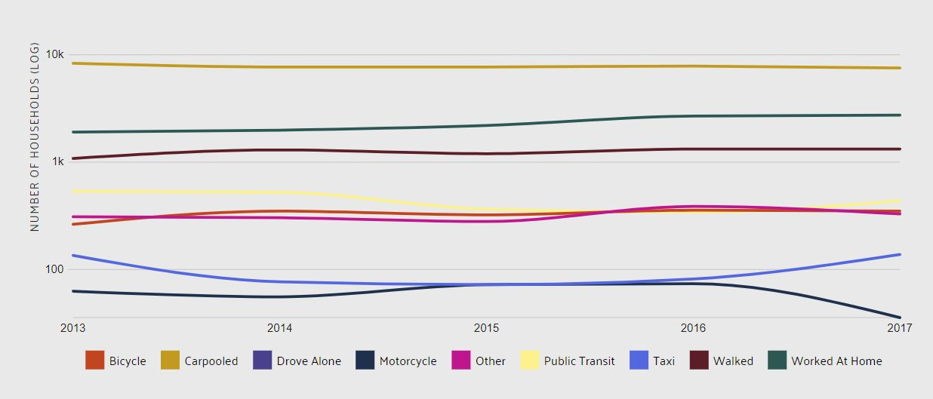
Group IX
Royce Dickerson, Ben Leonard, Kelsi Long,
Zac Pate, and William Roberts
Alabama Transportation Policy Research Center
Project Activities
Evidence of Need
Intended Outcomes
Sustainability
Working with the Alabama Transportation Policy Research Center, Group IX and the Blackburn community will organize county constituents and relevant stakeholder groups to present a whitepaper to the Tuscaloosa County Commission that makes the case for applying for a 5311 grant. Using the whitepaper and other briefing materials, Group IX will then make a presentation to the Probate Judge and County Commission. In the presentation, Group IX will argue that this investment of time and money can improve the livelihoods of many of their constituents.
We will invite the Blackburn community, members of the County Commission, and students from UA’s campus to participate in a “rural living simulation,” in which they will be tasked with planning an entire day using only public transportation. Key partners for this simulation will include the West Alabama Chamber of Commerce, the University of Alabama’s Center for Service and Leadership, the Alabama Transportation Institute, the Tuscaloosa Transit Authority, and the West Alabama Regional Commission.
For far too many people in Alabama, transportation is a major headache. Getting back and forth to work, transporting children home for school, buying groceries to cook dinner: all of these actions require reliable and safe transportation. For people living in rural areas, these tasks are increasingly difficult to accomplish.
At the completion of our whitepaper presentation, the County Commission will have a both factual and personal look at the necessity of public transportation in the rural Tuscaloosa County. In addition, the Commission will have a realistic idea of how to apply for and obtain a 5311 grant.
By working with a variety of organizations across Tuscaloosa County, Western Alabama, and Central Alabama, Group IX will make a convincing case to the Tuscaloosa County Commission to apply for a 5311 grant. Group IX intends to display all the evidence for need in the public transportation sector in rural Tuscaloosa.
Tuscaloosa County has not applied for 5311 funding since the early 1970’s, leaving millions of federal dollars on the table and thousands of residents without access to reliable public transit. Group IX’s research and whitepaper, when presented to the Tuscaloosa County Commission and Probate Judge, will consist of the facts and data on the necessity for expanding public transportation in rural areas.
Hopefully, through these presentations, the County Commission will be convinced to apply for the funding. If the funding is received, the County Commission and the Tuscaloosa Transit Authority will likely work out an agreement to operate demand response vans in rural areas of Tuscaloosa County. The demand for public transportation has held constant, as shown in Figure 2, but Tuscaloosa County can get ahead of other communities in the state and region by addressing this issue head-on.
The Alabama Transportation Institute, the Tuscaloosa County Commission, and the Tuscaloosa Transit Authority are established organizations and governmental entities, making this project sustainable into the future and allowing for greater study into the rural transportation issue in Tuscaloosa County. If the County Commission decides to apply for 5311 funding, it will be up to the Commission to draft a proposal to the Federal Transit Administration. And, if the funding for the vans is received, the Commission will likely transfer the money to the Tuscaloosa Transit Authority, the organization that would operate the vans.
If successful, the “rural living and public transportation” simulation will provide another sustainable program that can be used and replicated by the Center for Service and Leadership, Blackburn Institute, or other University organizations that wish to give students valuable experiential knowledge about some of the hardships of living in a rural area, like Tuscaloosa County.
Working with a diverse group of organizations, Group IX will lay
out a long-term and
sustainable path forward
for the County to follow
long after the funding
is applied for.
Group IX, along with the Blackburn class and greater Blackburn community, will plan a “rural living simulation” to better understand the daily lives of people who rely solely on
public transportation.
5311 funding was enacted to encourage safe and effective public transportation to rural areas. This grant from the Federal Transit Administration helps alleviate some of these needs.
Figure 1
Currently, Tuscaloosa County does not have a public transportation system that serves beyond the City of Tuscaloosa limits (see Figure 1), leaving people in the rural areas of Tuscaloosa County without an affordable transportation method. Over the past two years, demand for public transportation has risen, since the costs associated with purchasing and maintaining a personal vehicle are rising, especially after the recent passage of the gas tax increase in Alabama.
Between 2015-2017, there was an 18% increase in the public's demand for public transportation in Tuscaloosa, and as the county’s population continues to expand and include more people to serve, that demand will only increase.
The City has done a good job by providing some public transportation options to lower income residents, but these routes do not go to many skilled labor worksites or serve residents in rural Tuscaloosa County.
Tuscaloosa County has a walkability score of 33. In comparison, Charleston, South Carolina has a walkability score of 4o and New York City has a walkability score of 89.
Figure 2
Figure 3
Bibliography
Tuscaloosa neighborhoods on Walk Score. (n.d.). Retrieved from https://www.walkscore.com/AL/Tuscaloosa.
Tuscaloosa County, AL. (n.d.). Retrieved from https://datausa.io/profile/geo/tuscaloosa-county-al.
Palmer, V. J. (n.d.). Tuscaloosa County Route Information . Retrieved from http://www.tuscaloosatransit.com/routeInfo.php.

